Slide 1
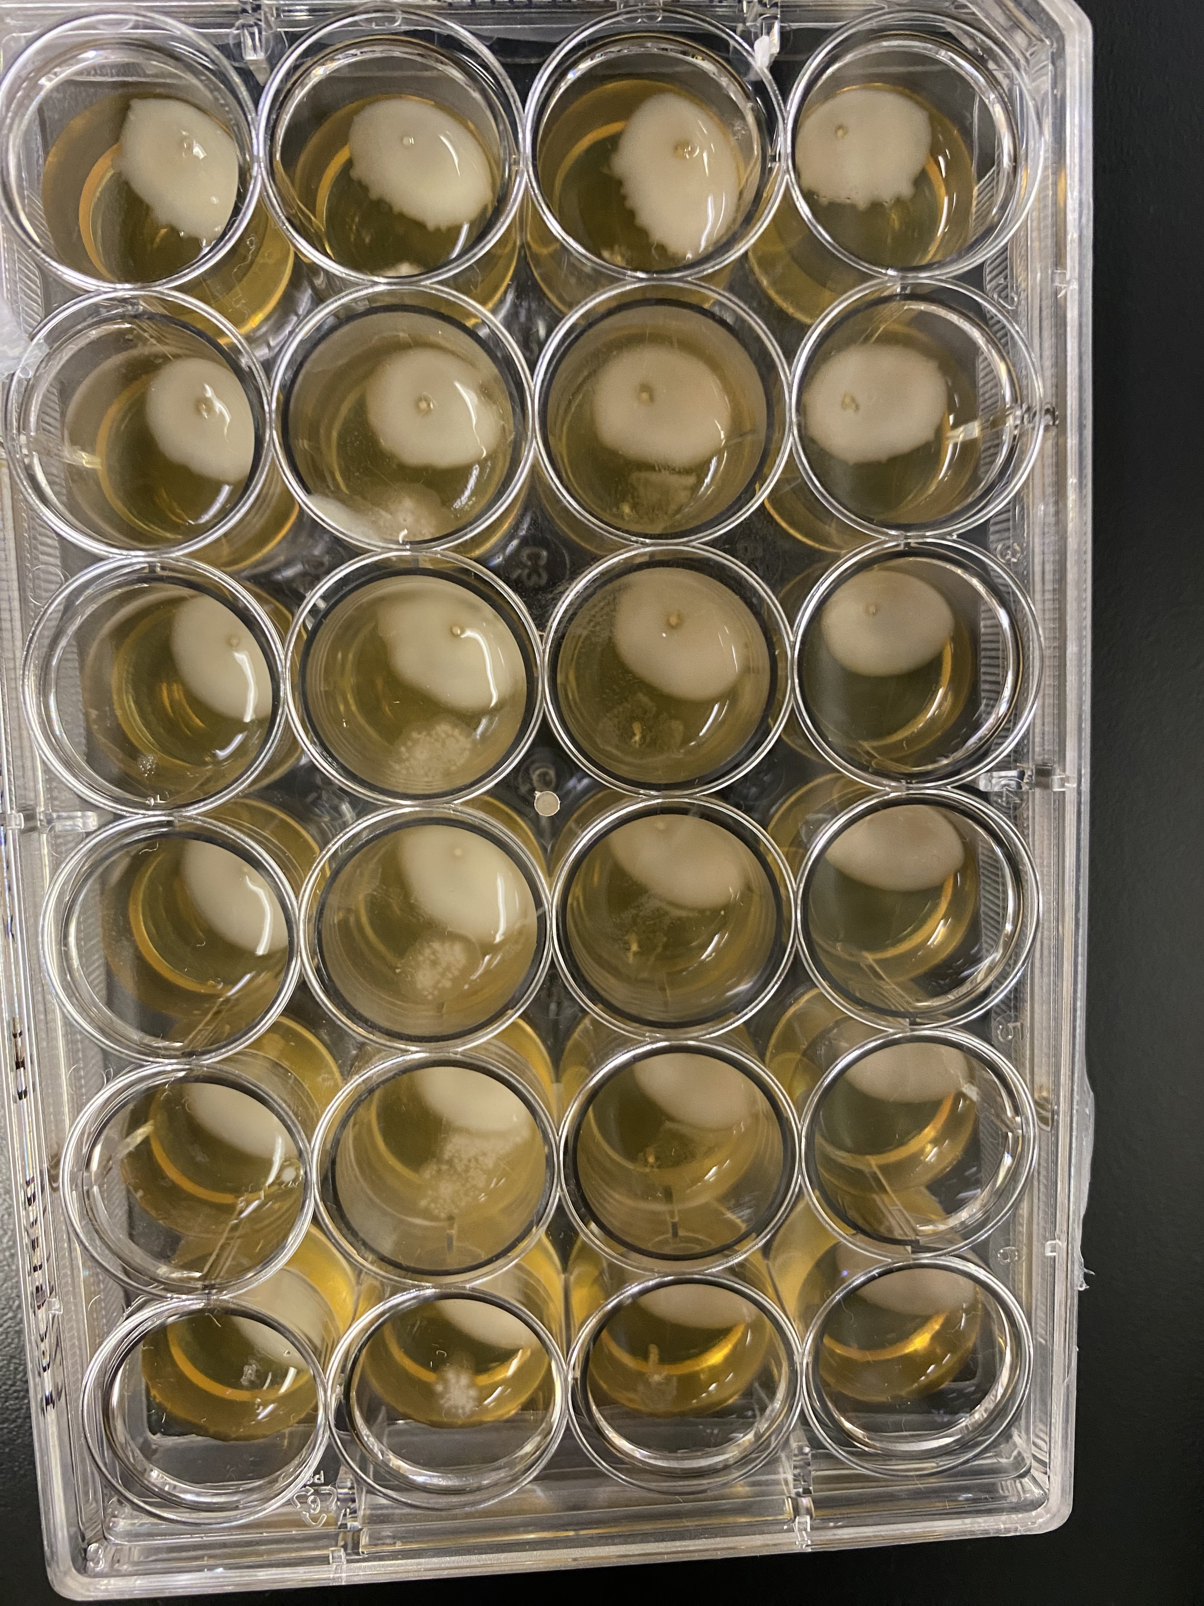
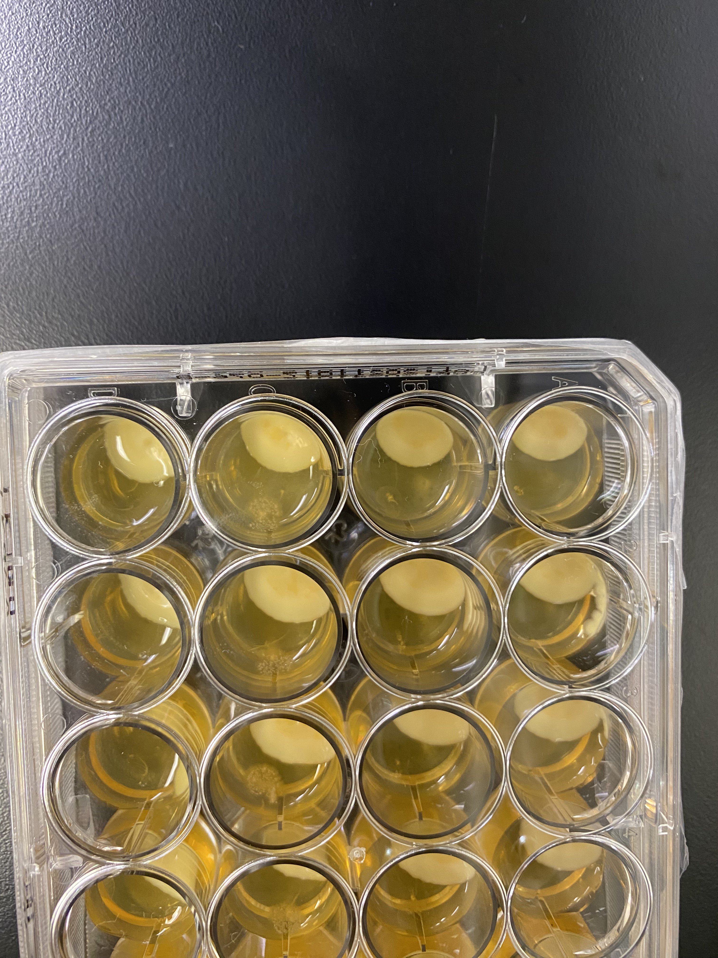
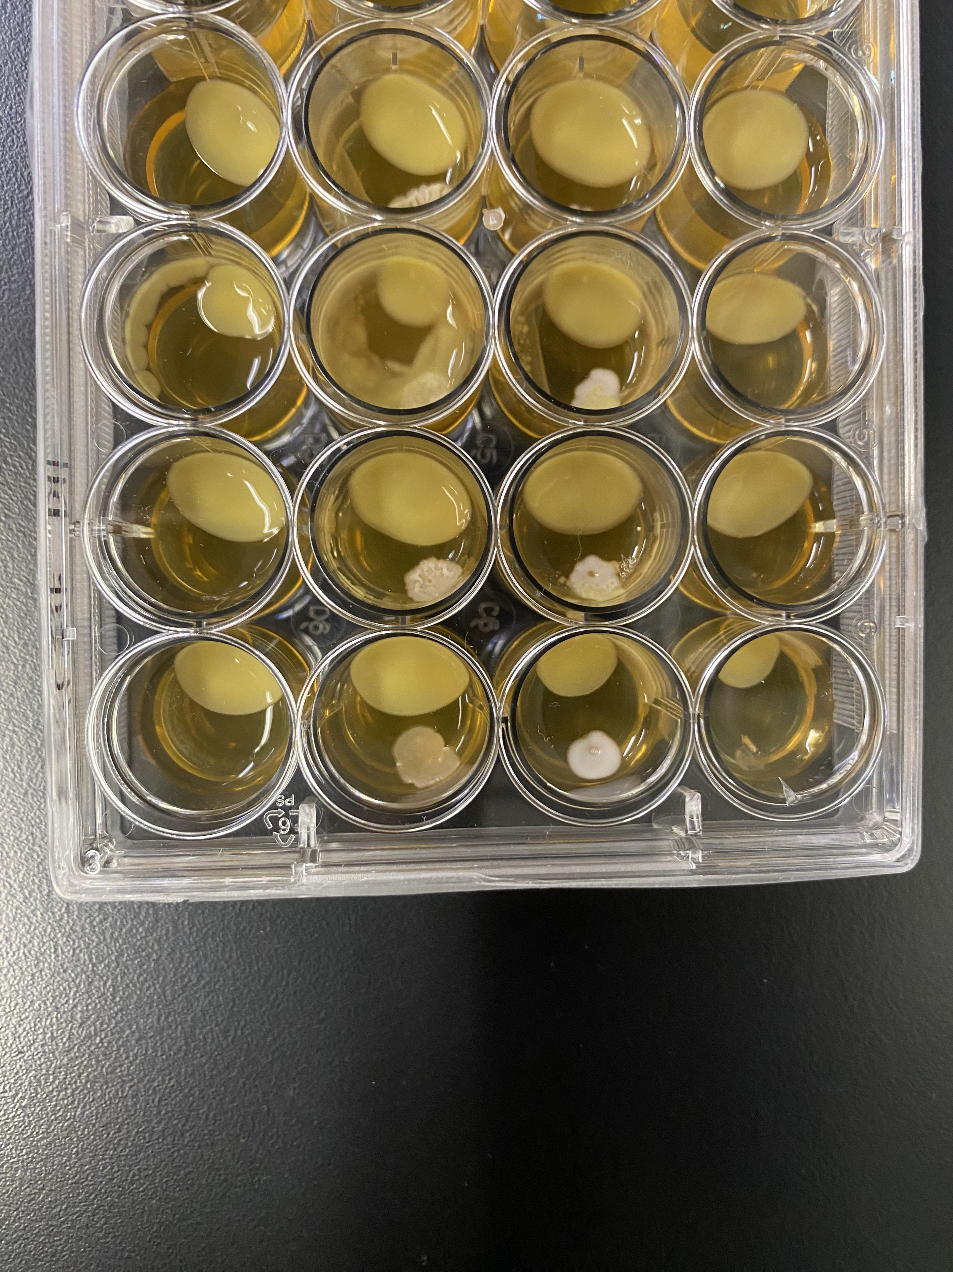
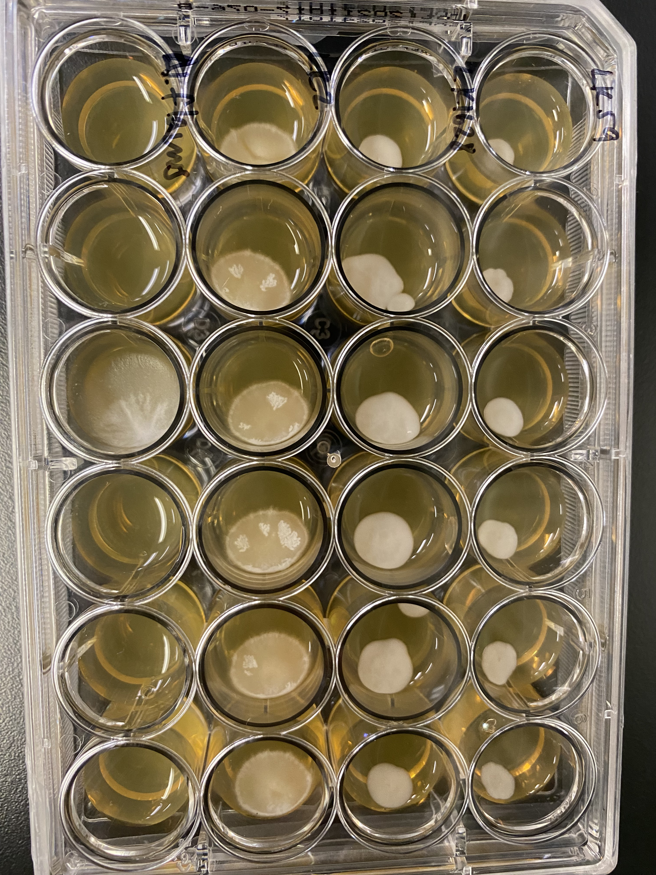
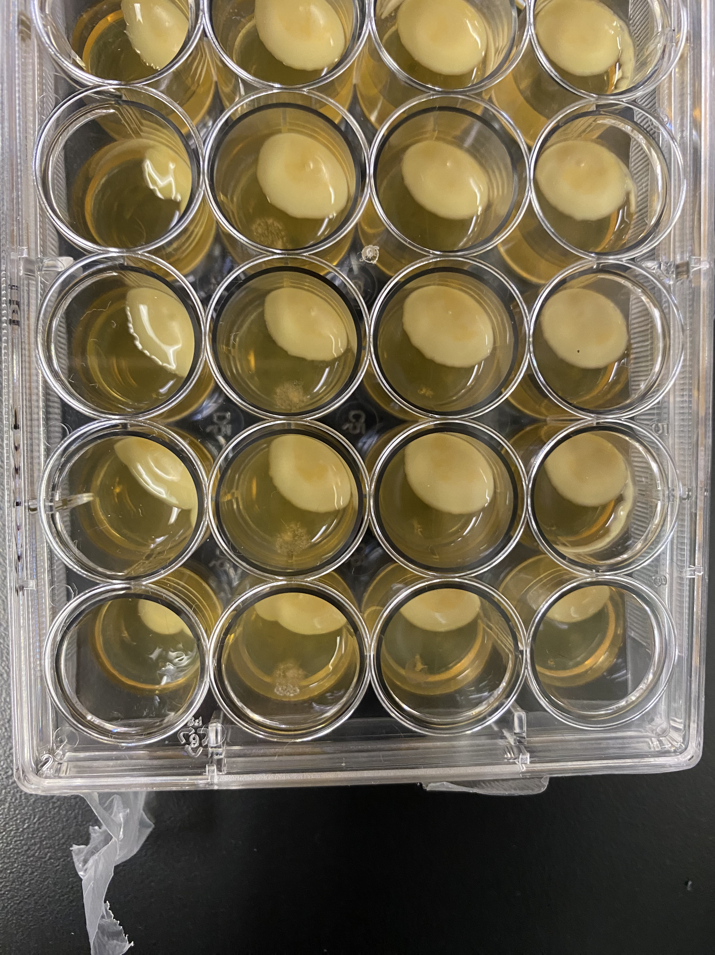
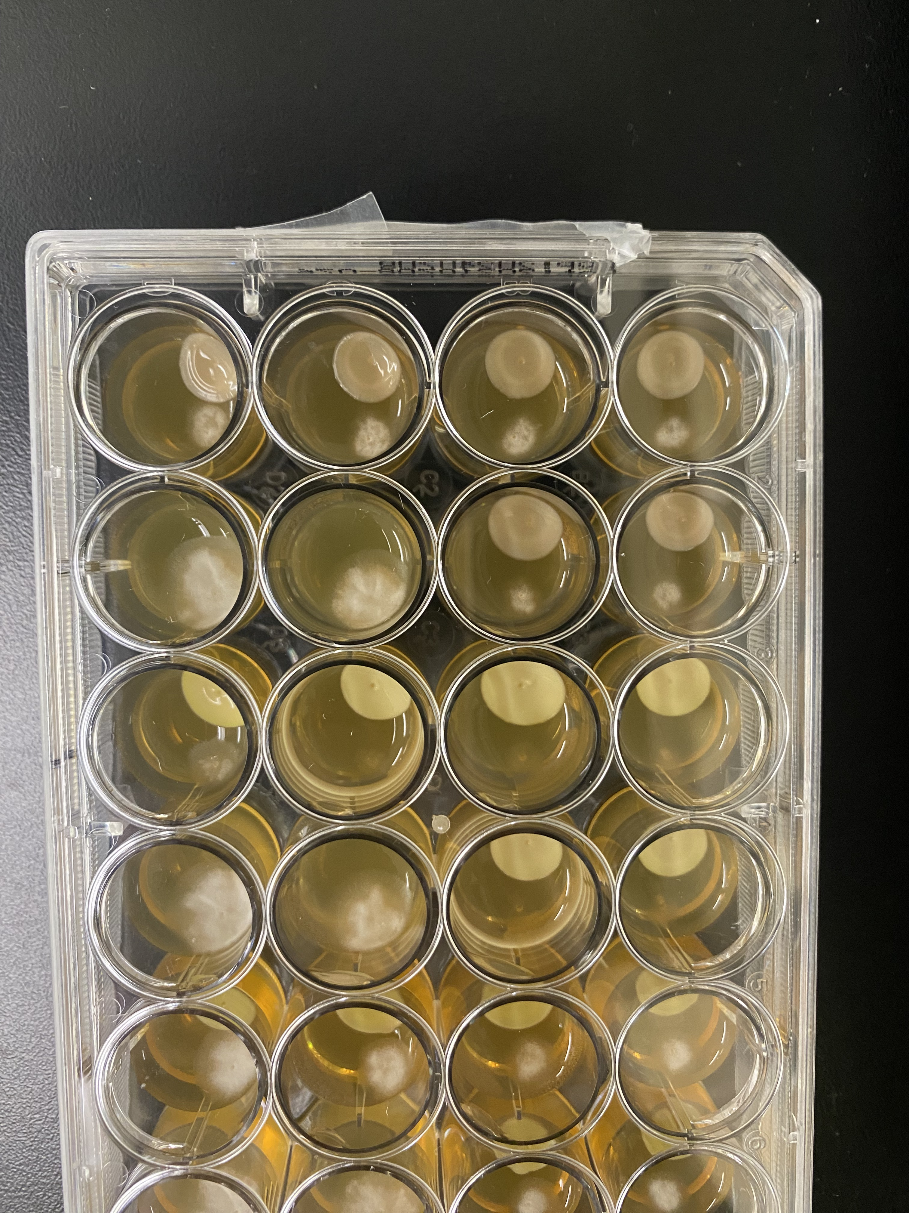
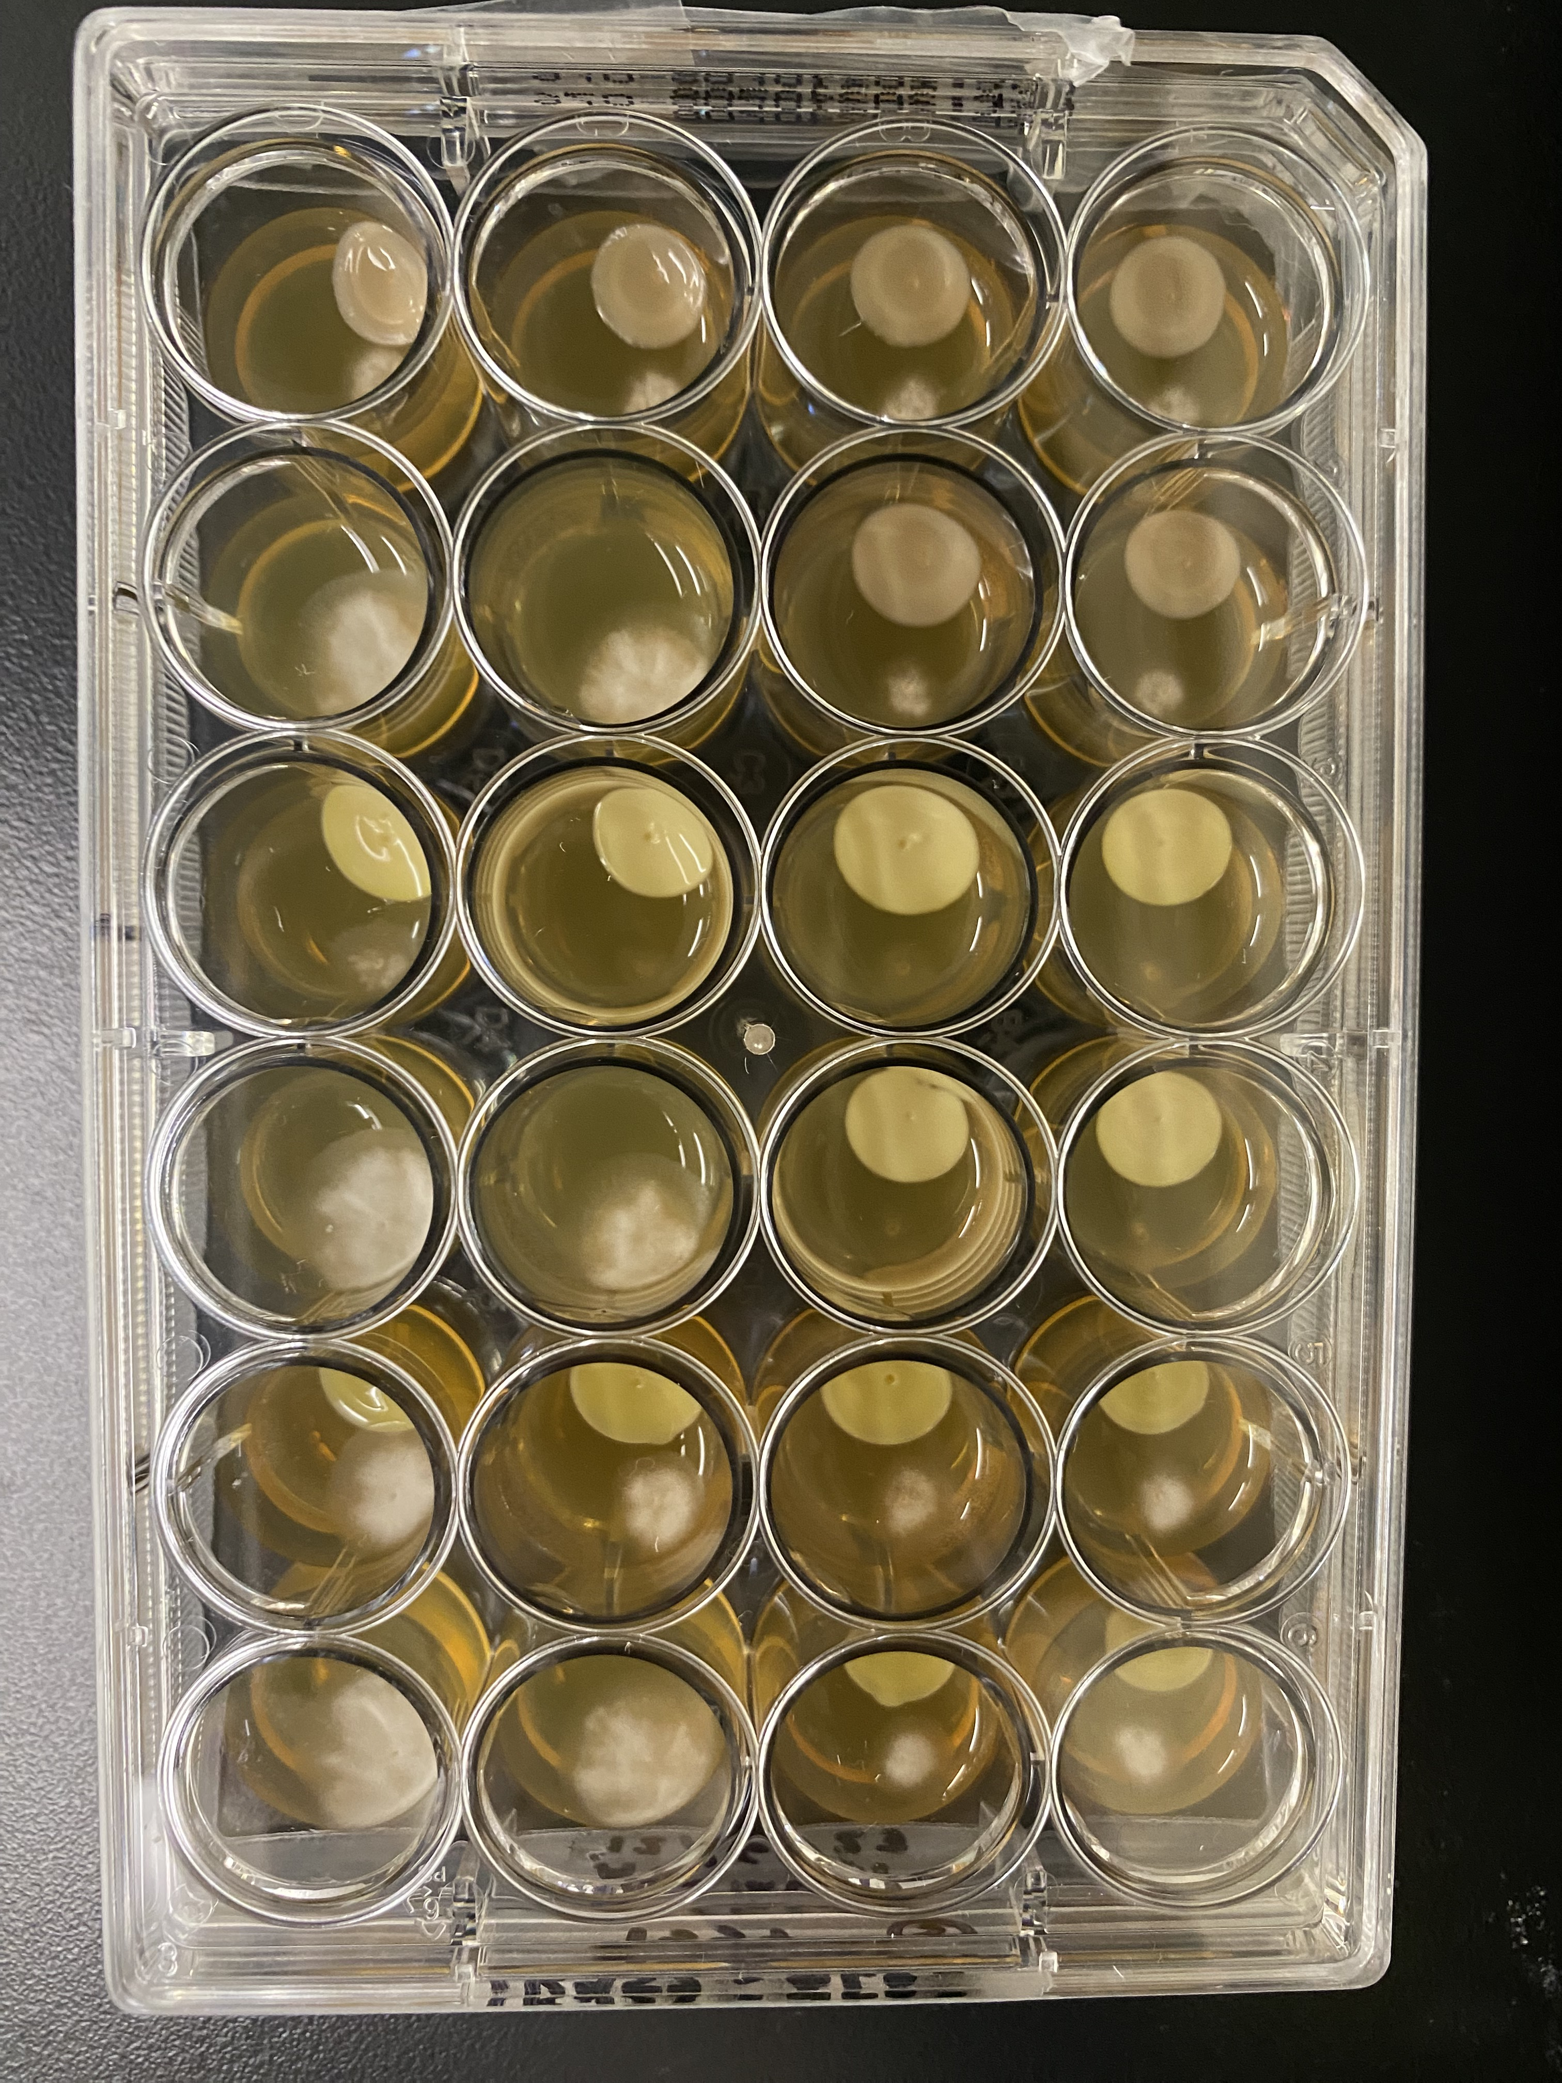
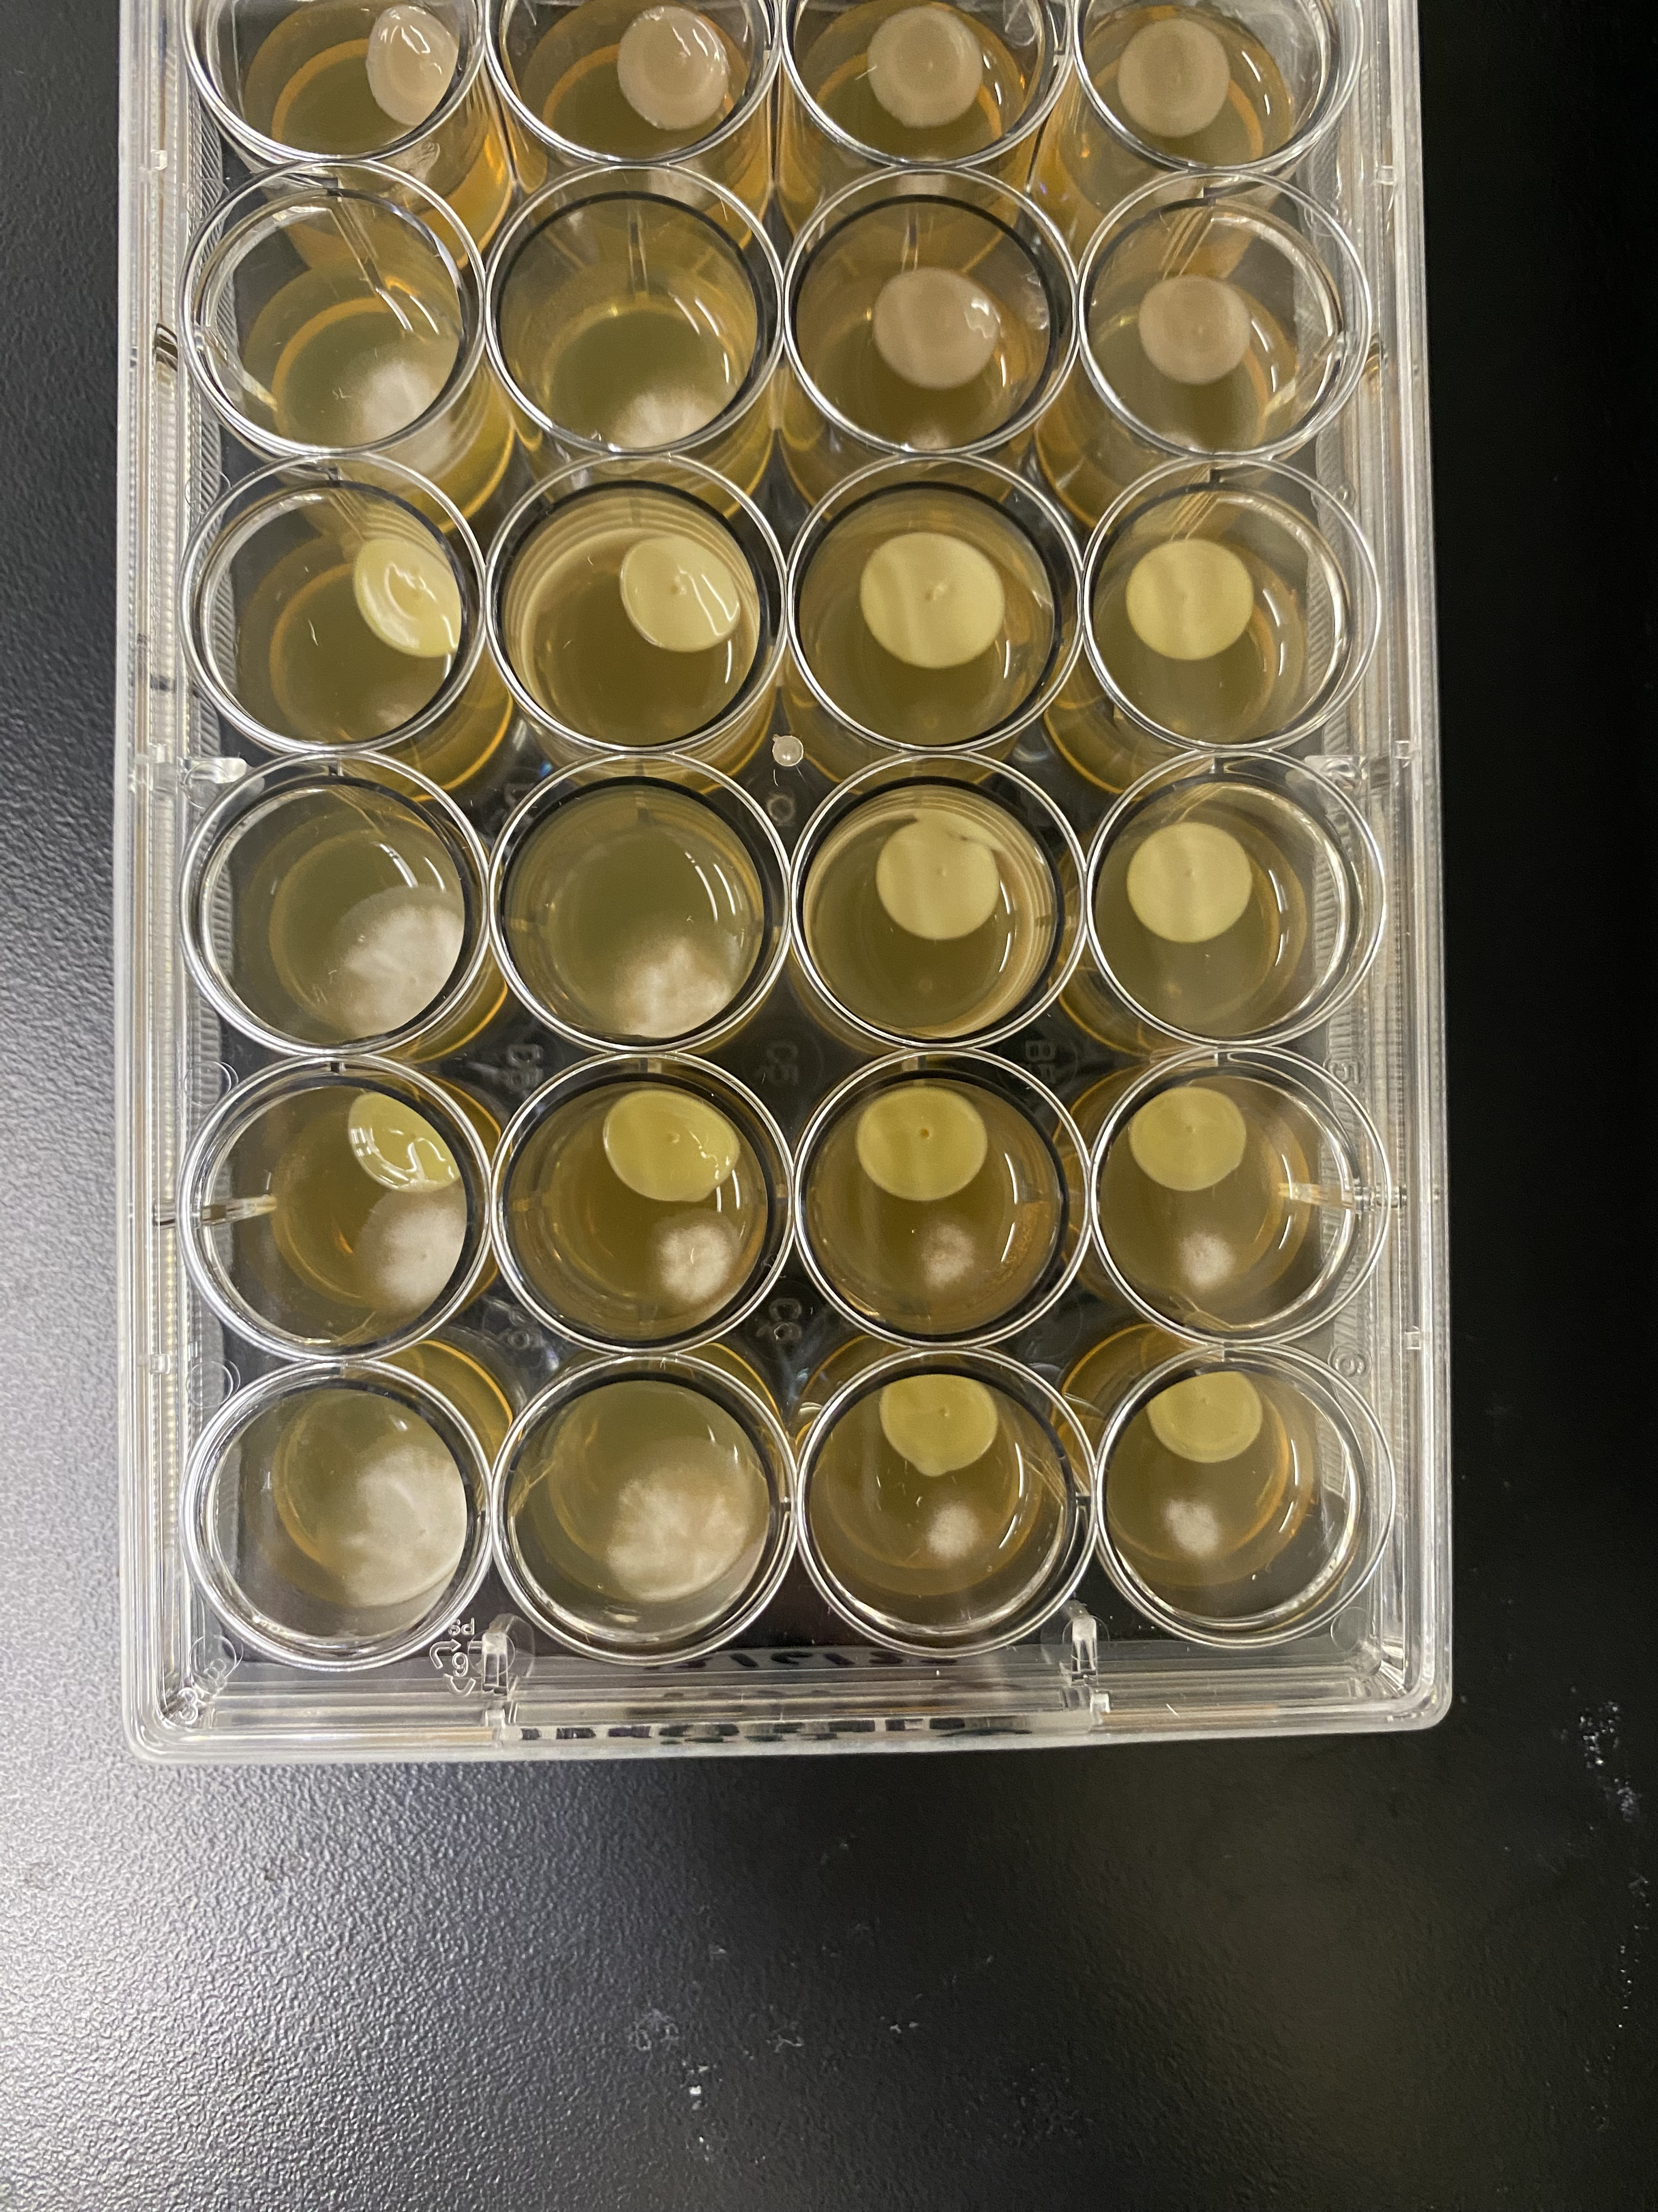
LK952
LK960
LK1337
Control
Candida albicans
Candida auris
Trichosporon asahii
Aspergillus flavus

Slide 2
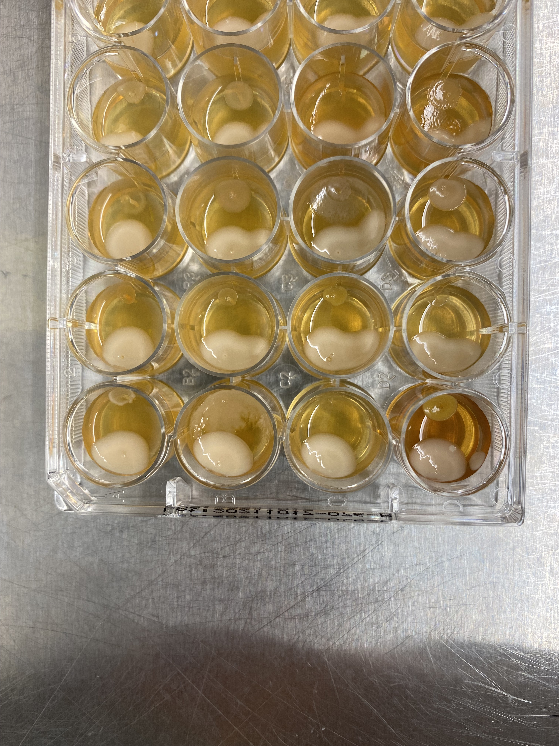
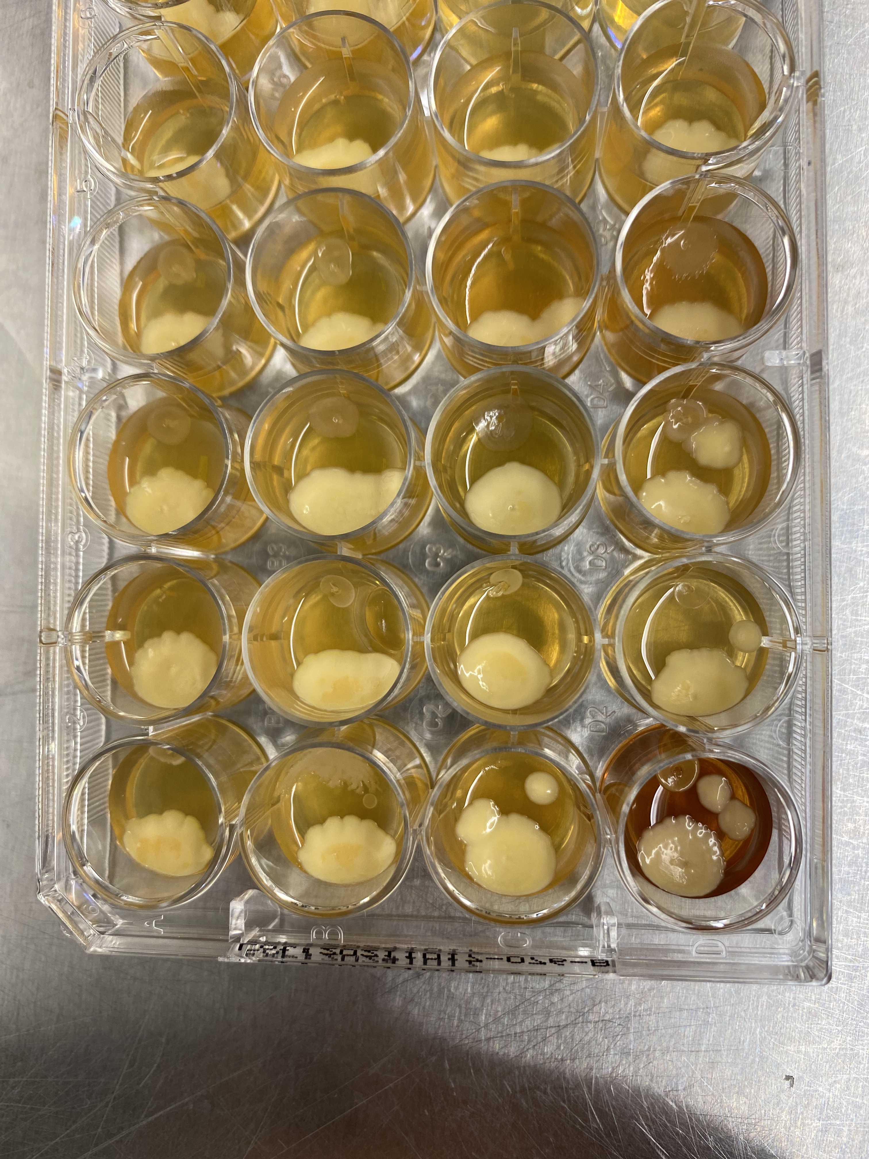
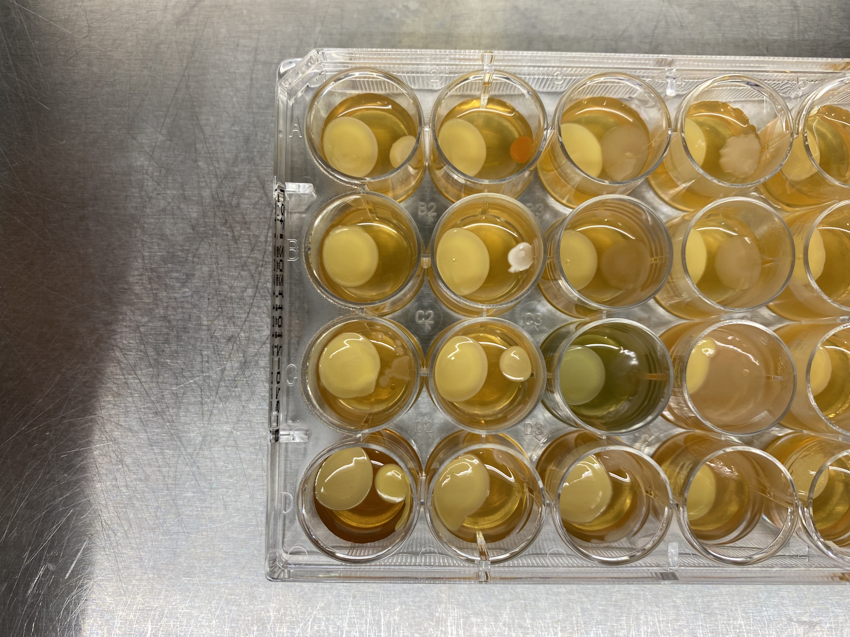
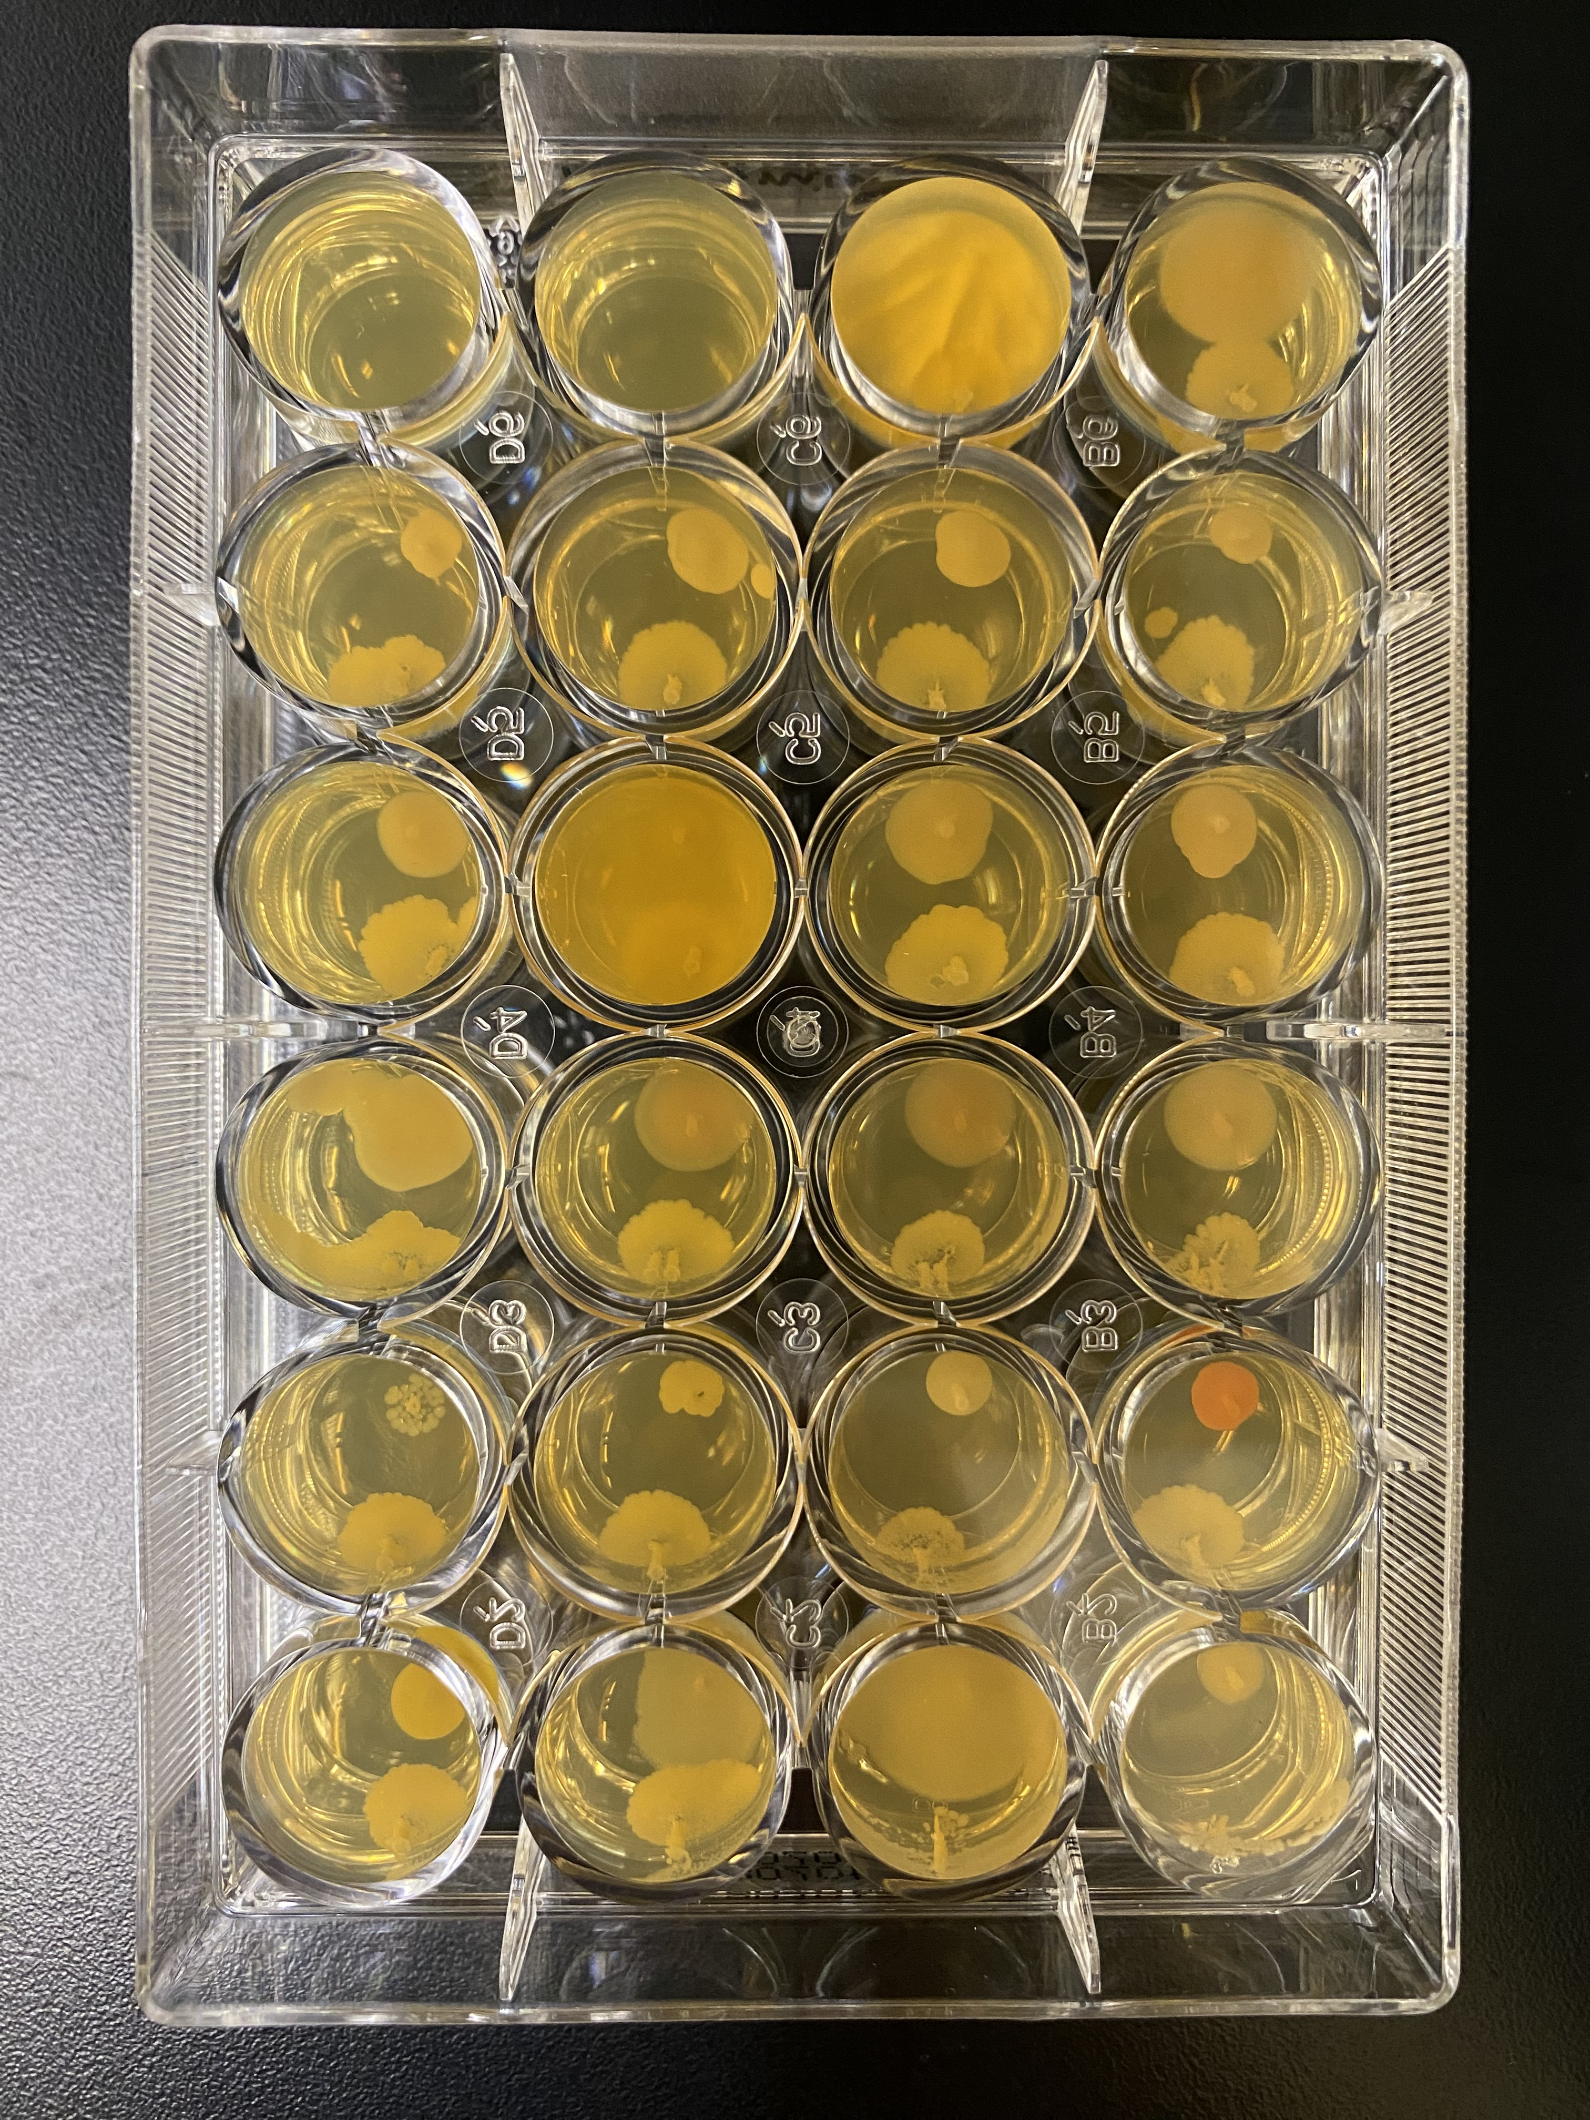
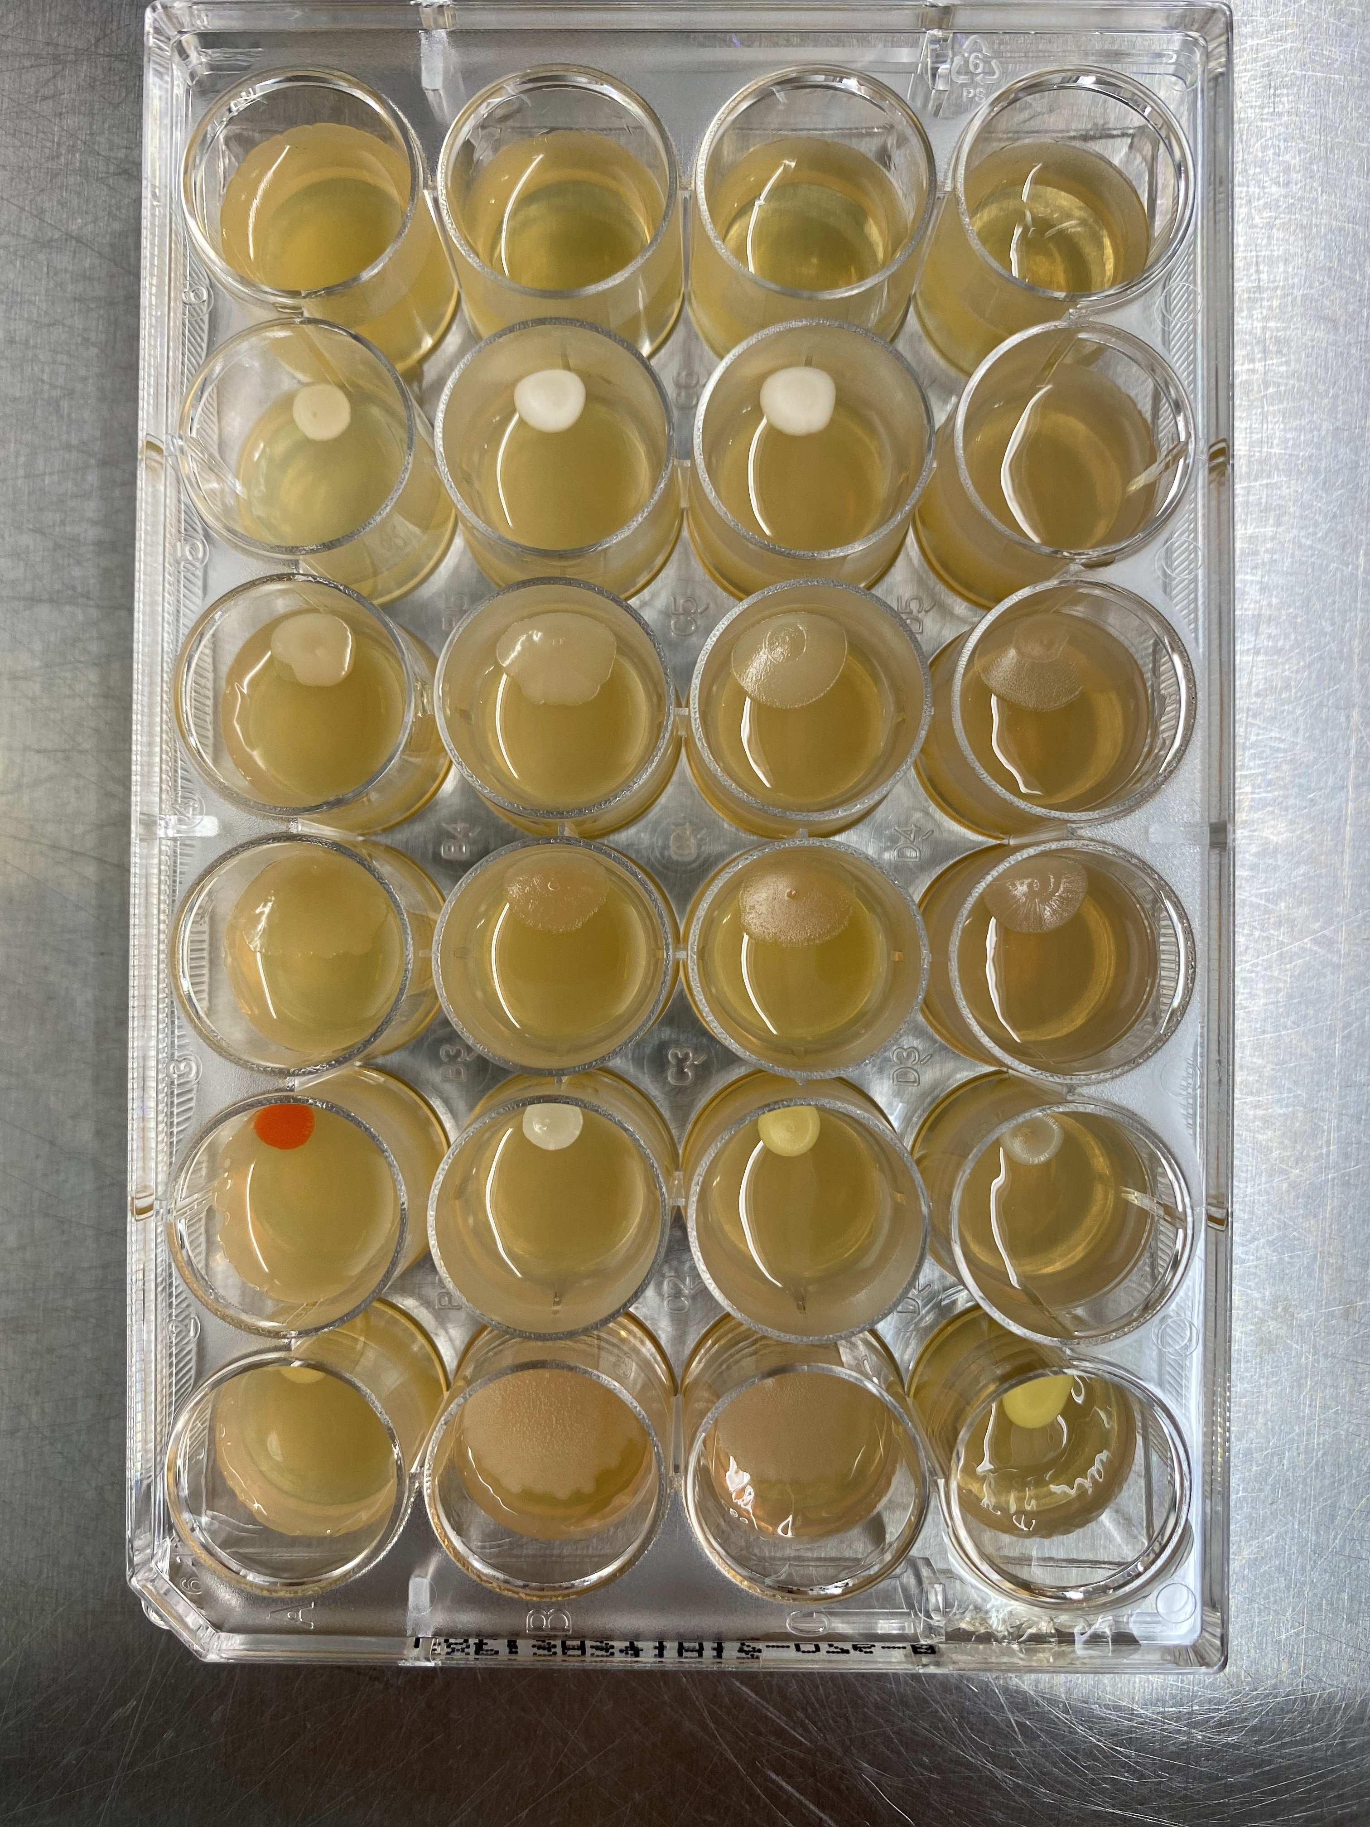
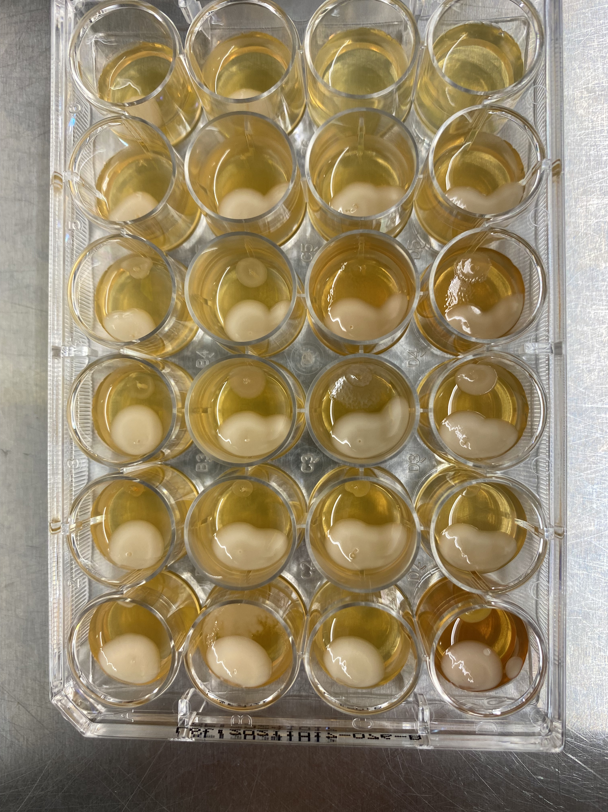
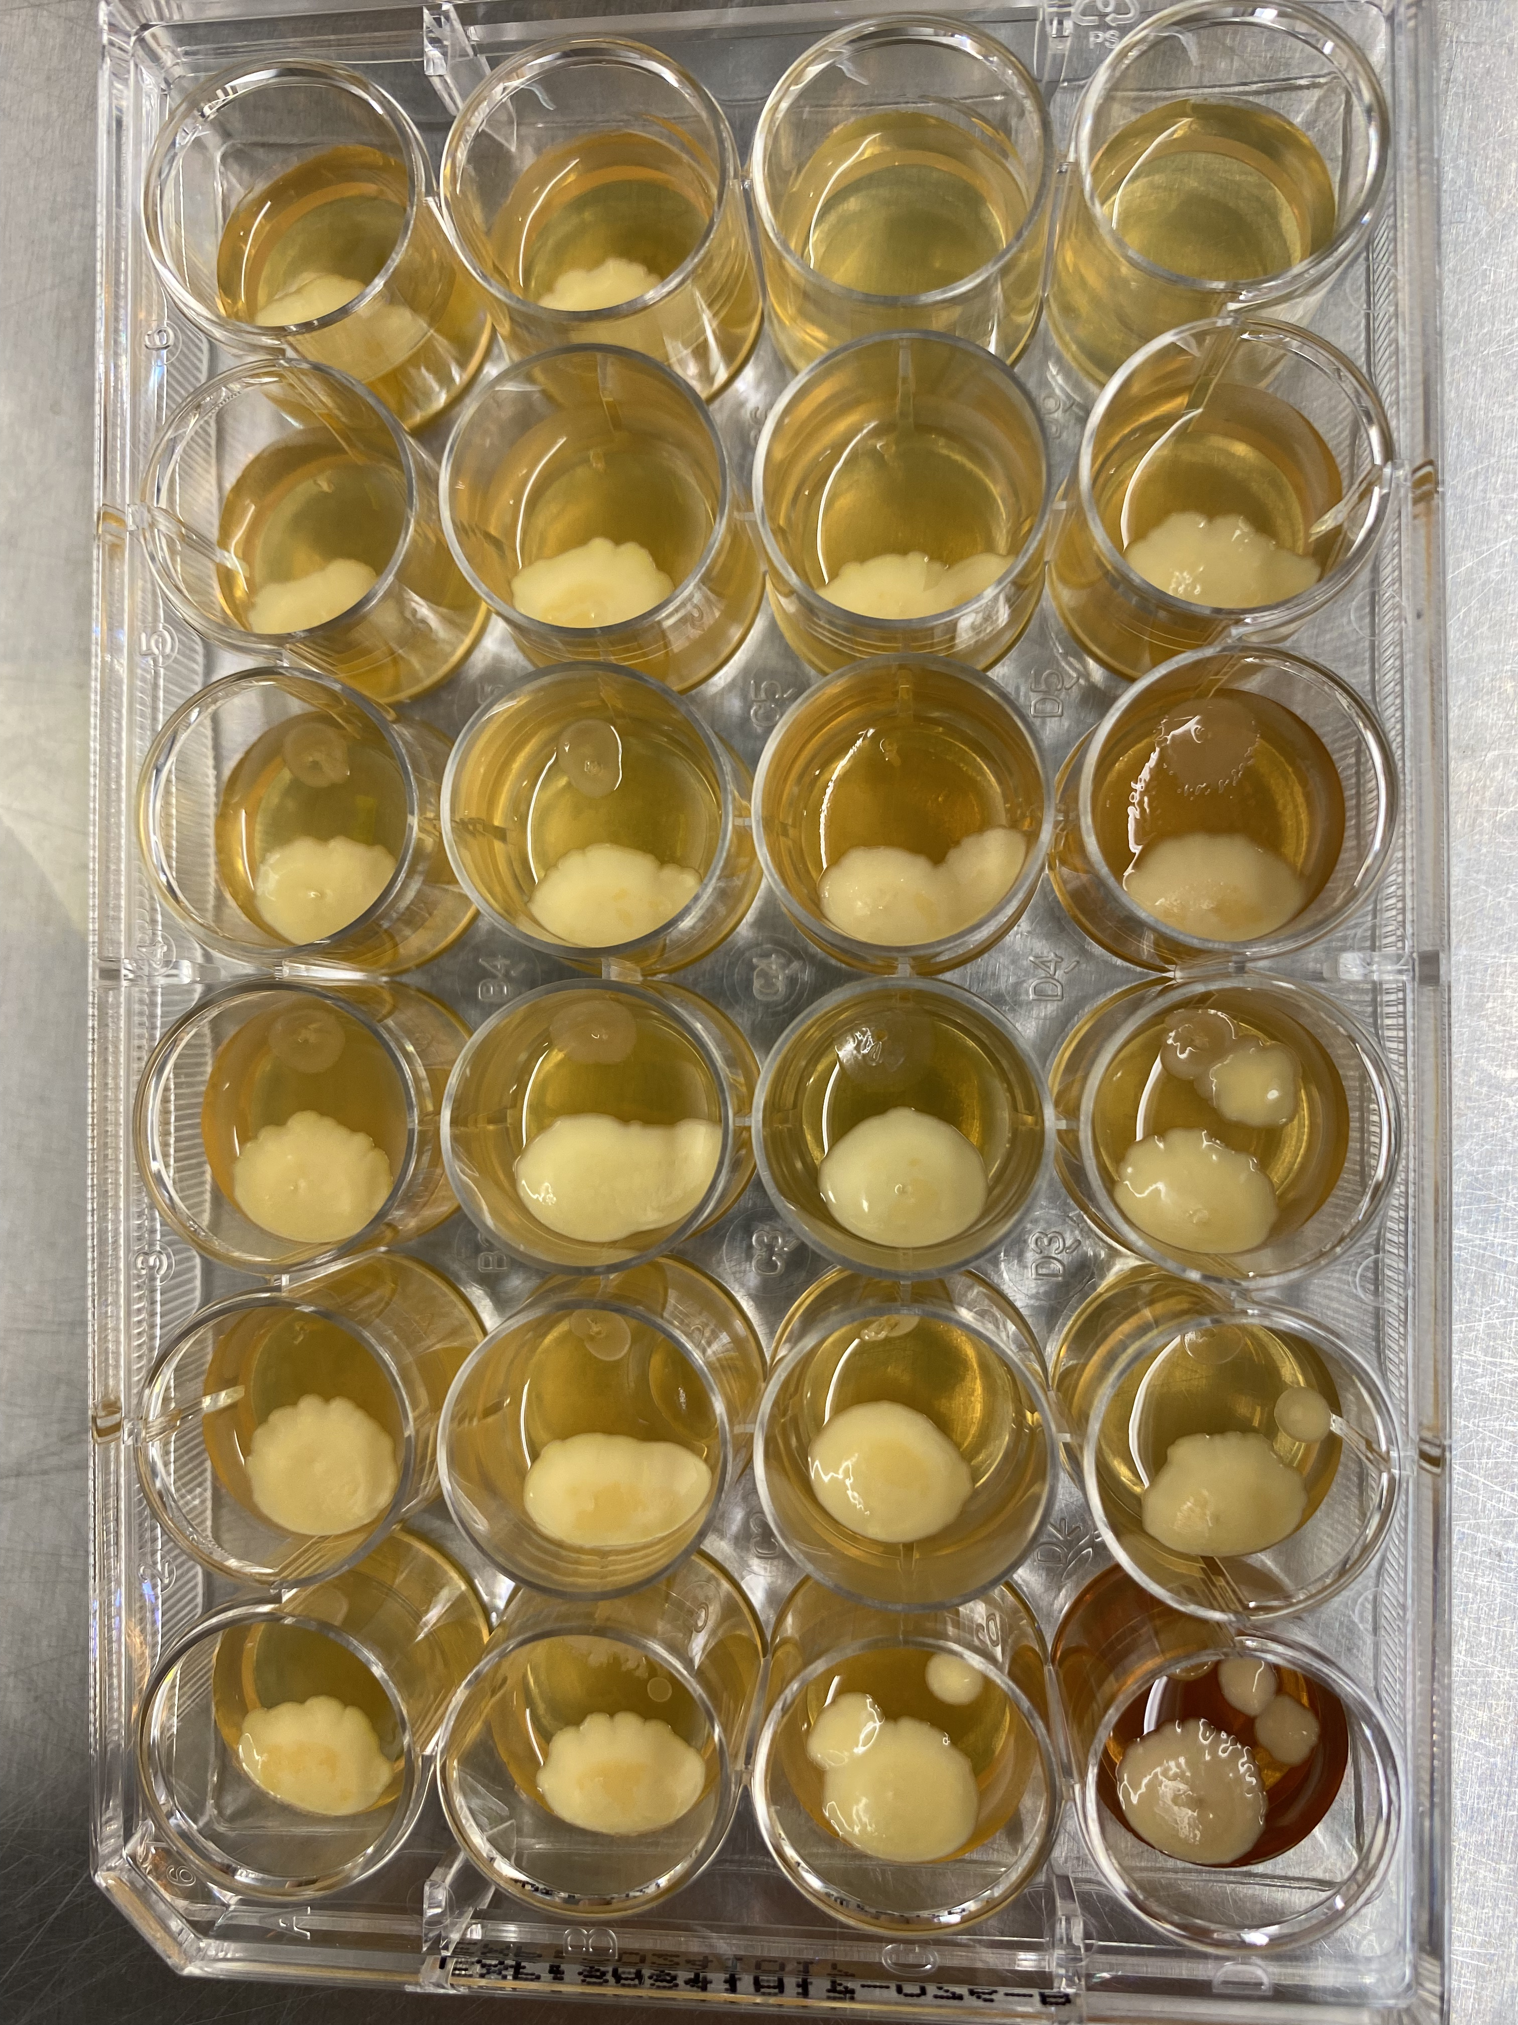
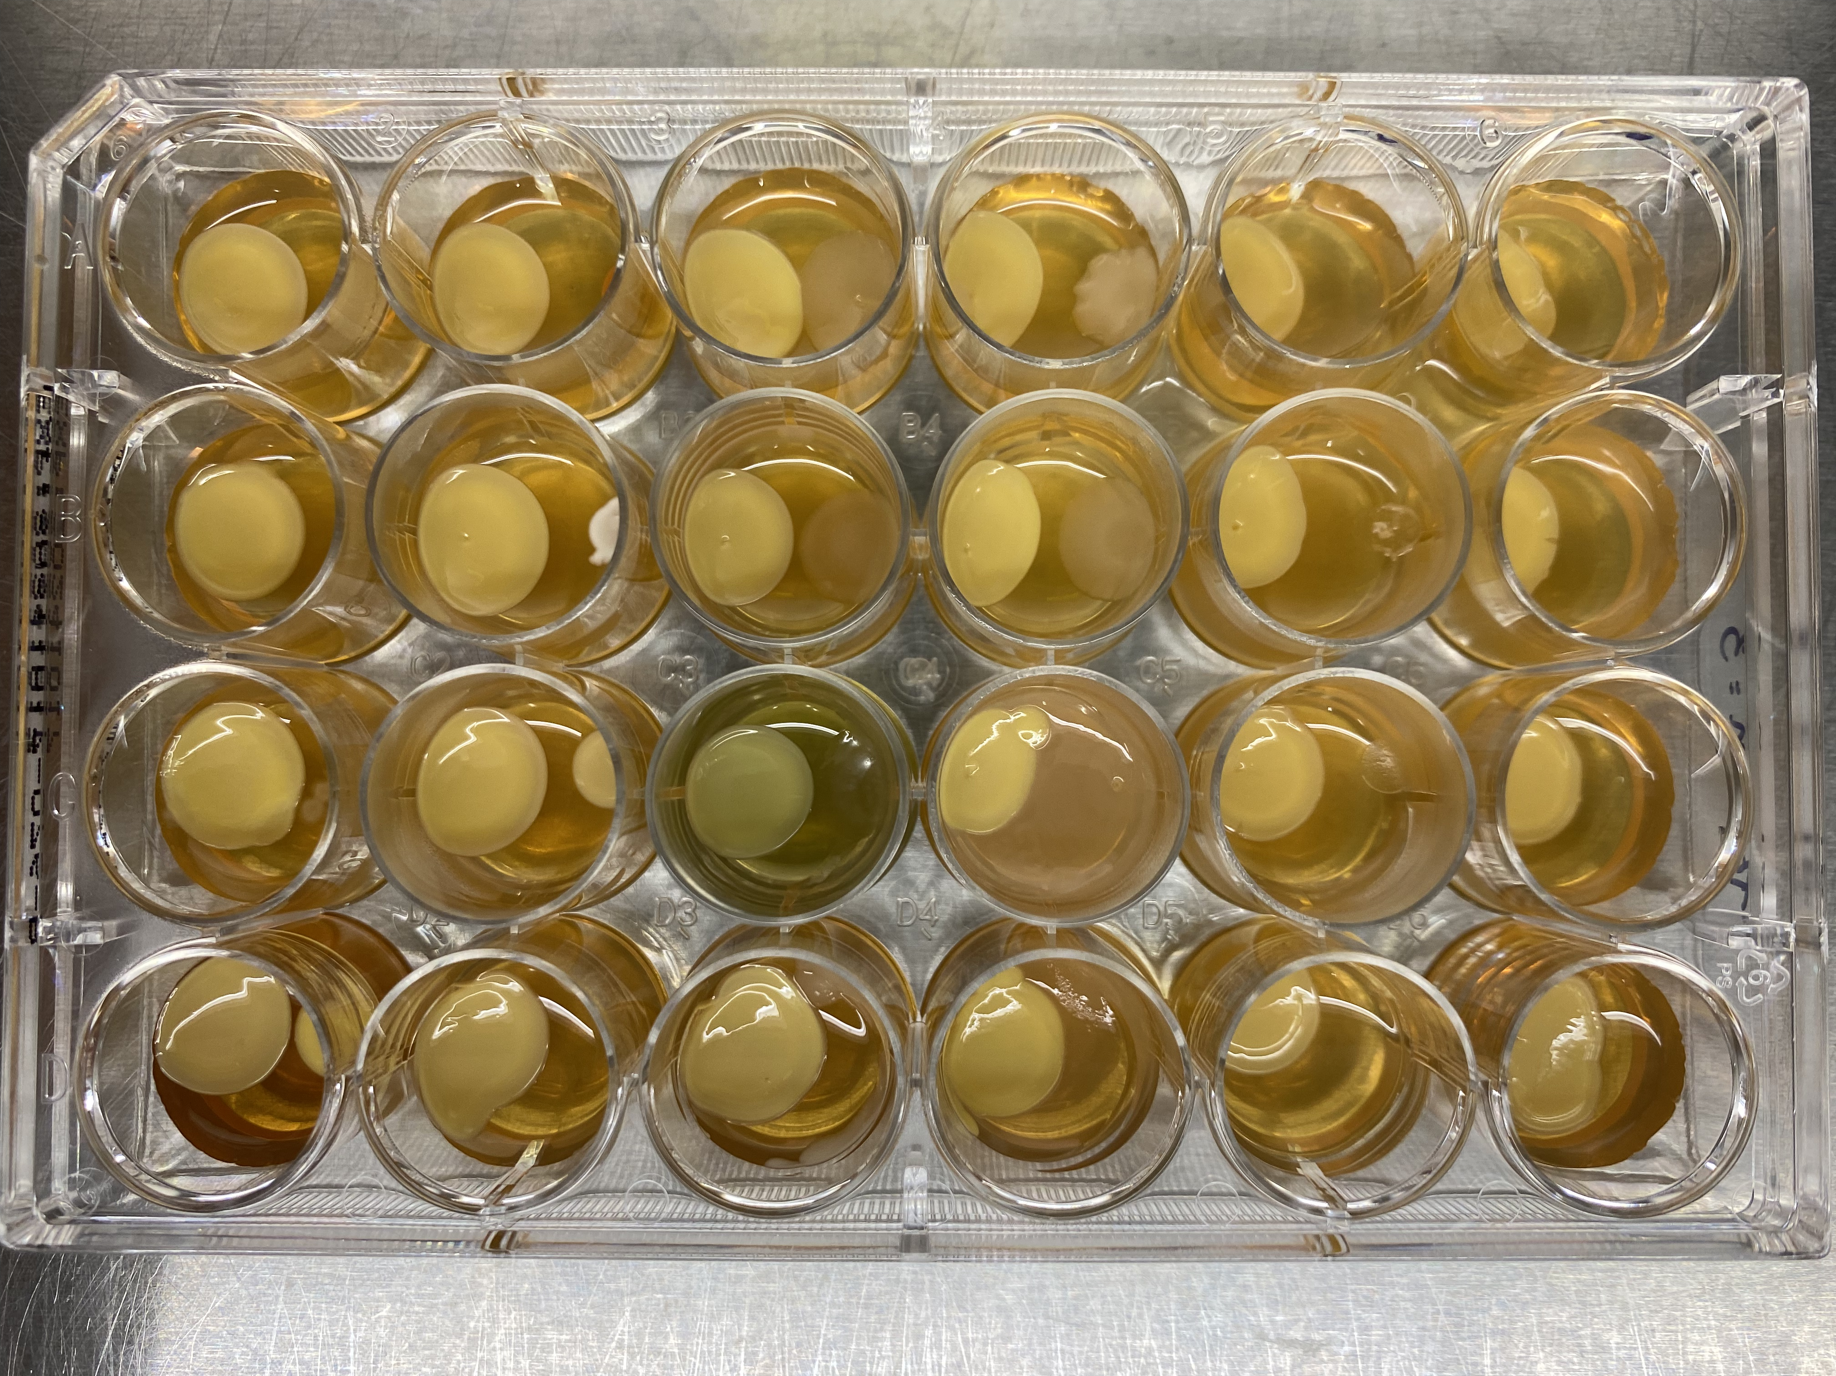
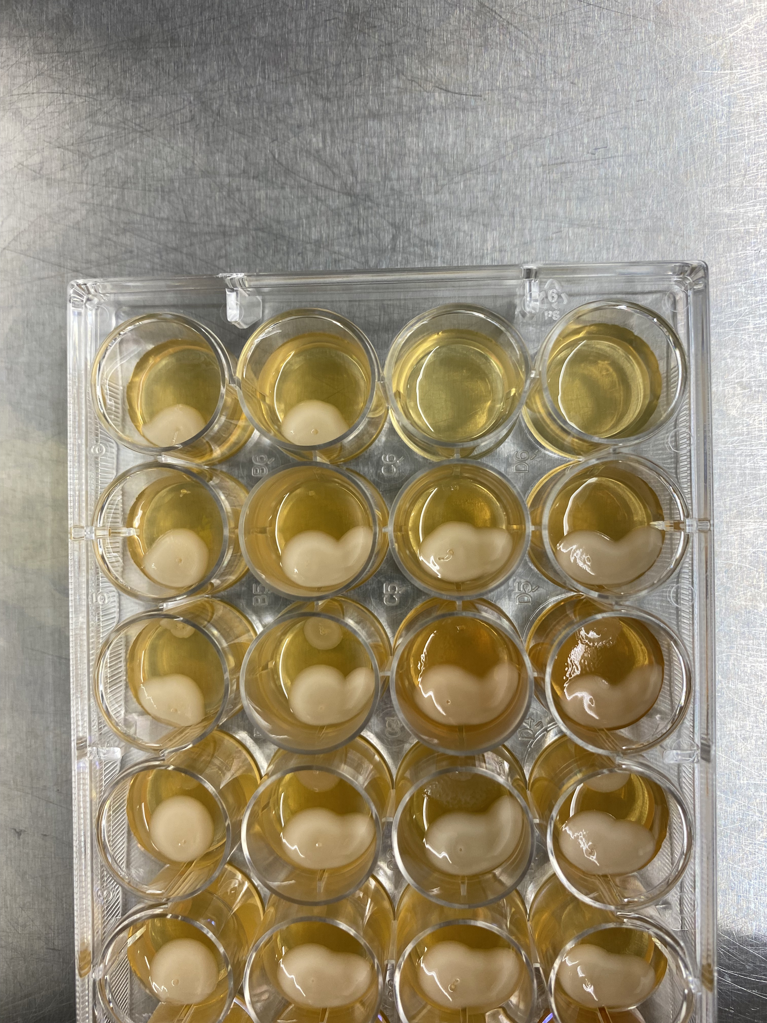
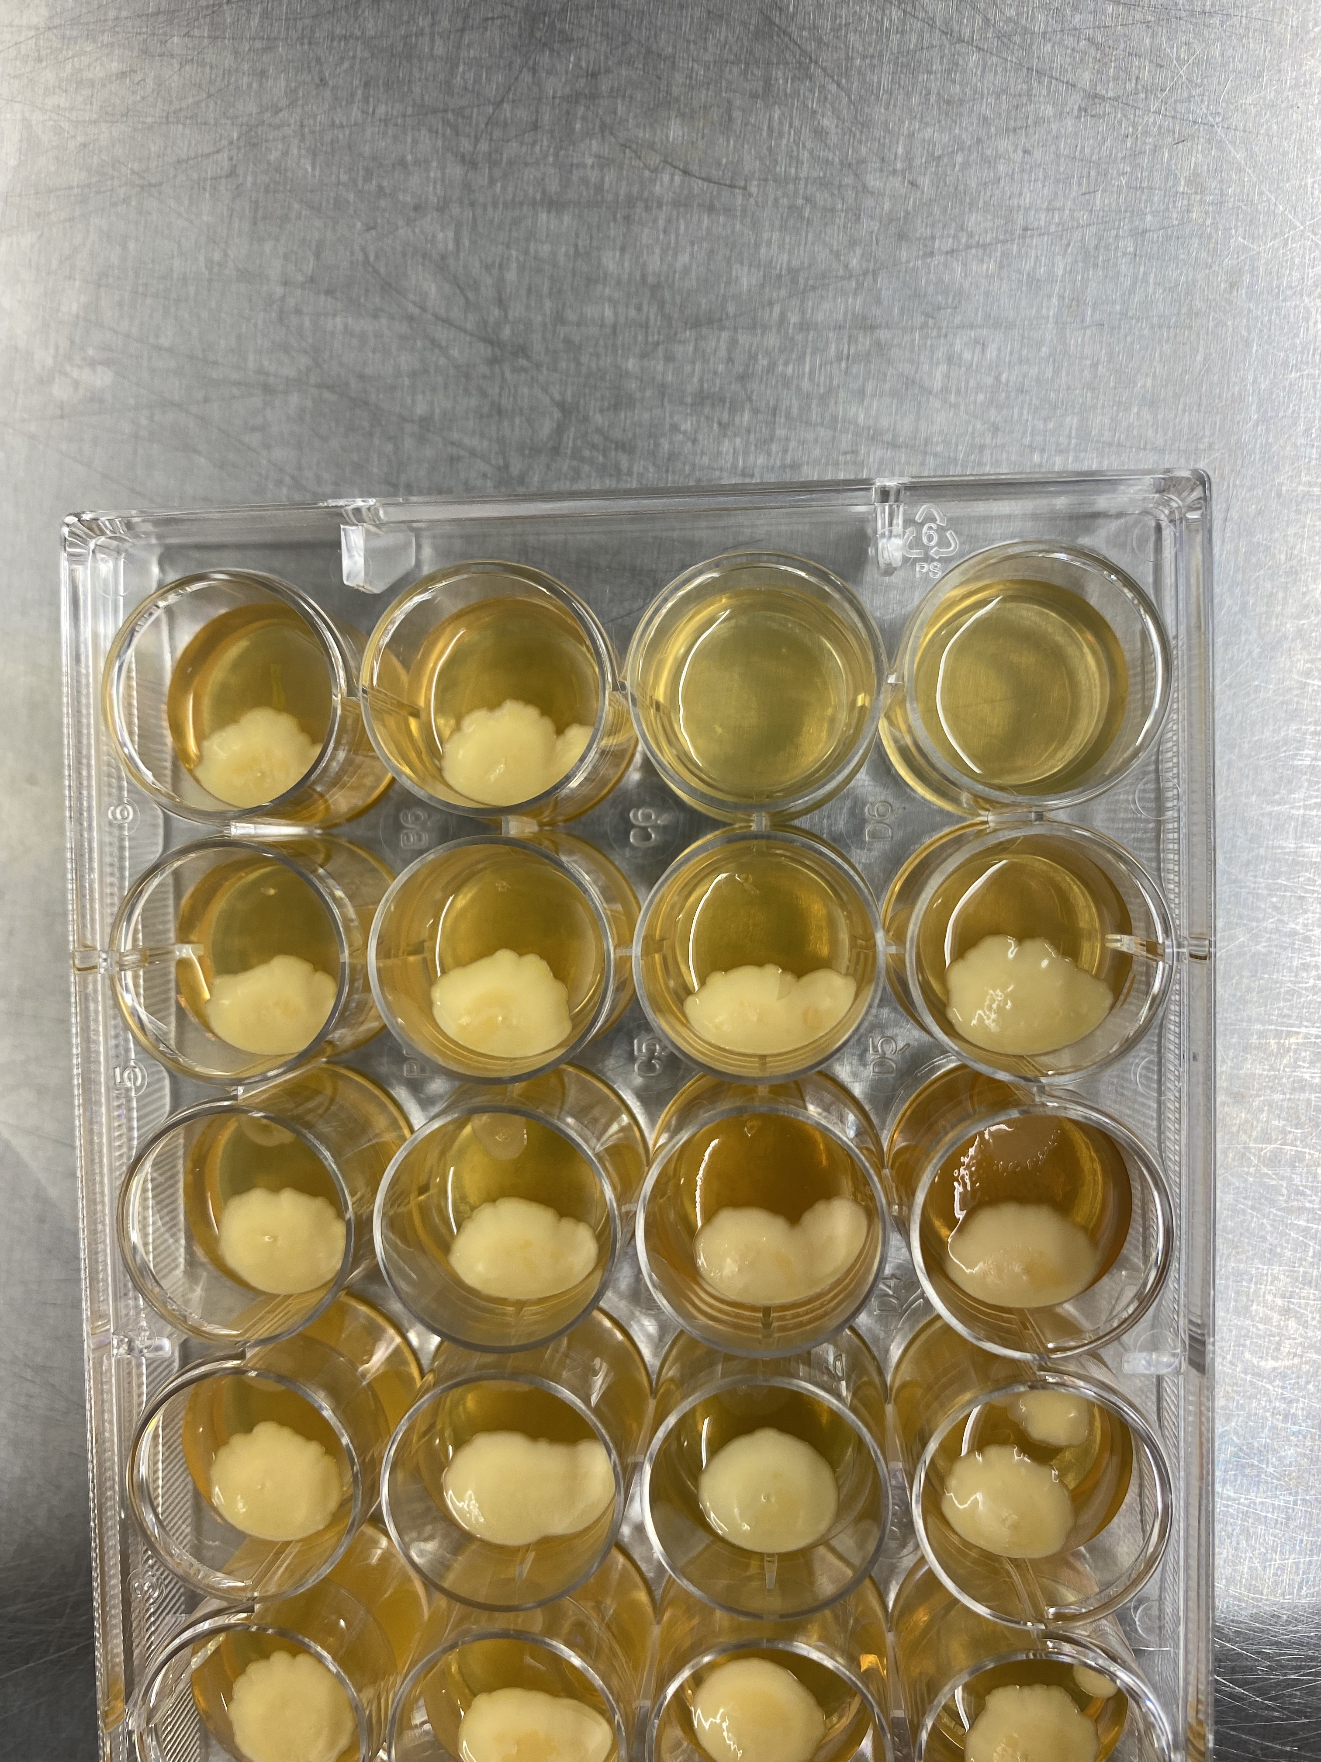
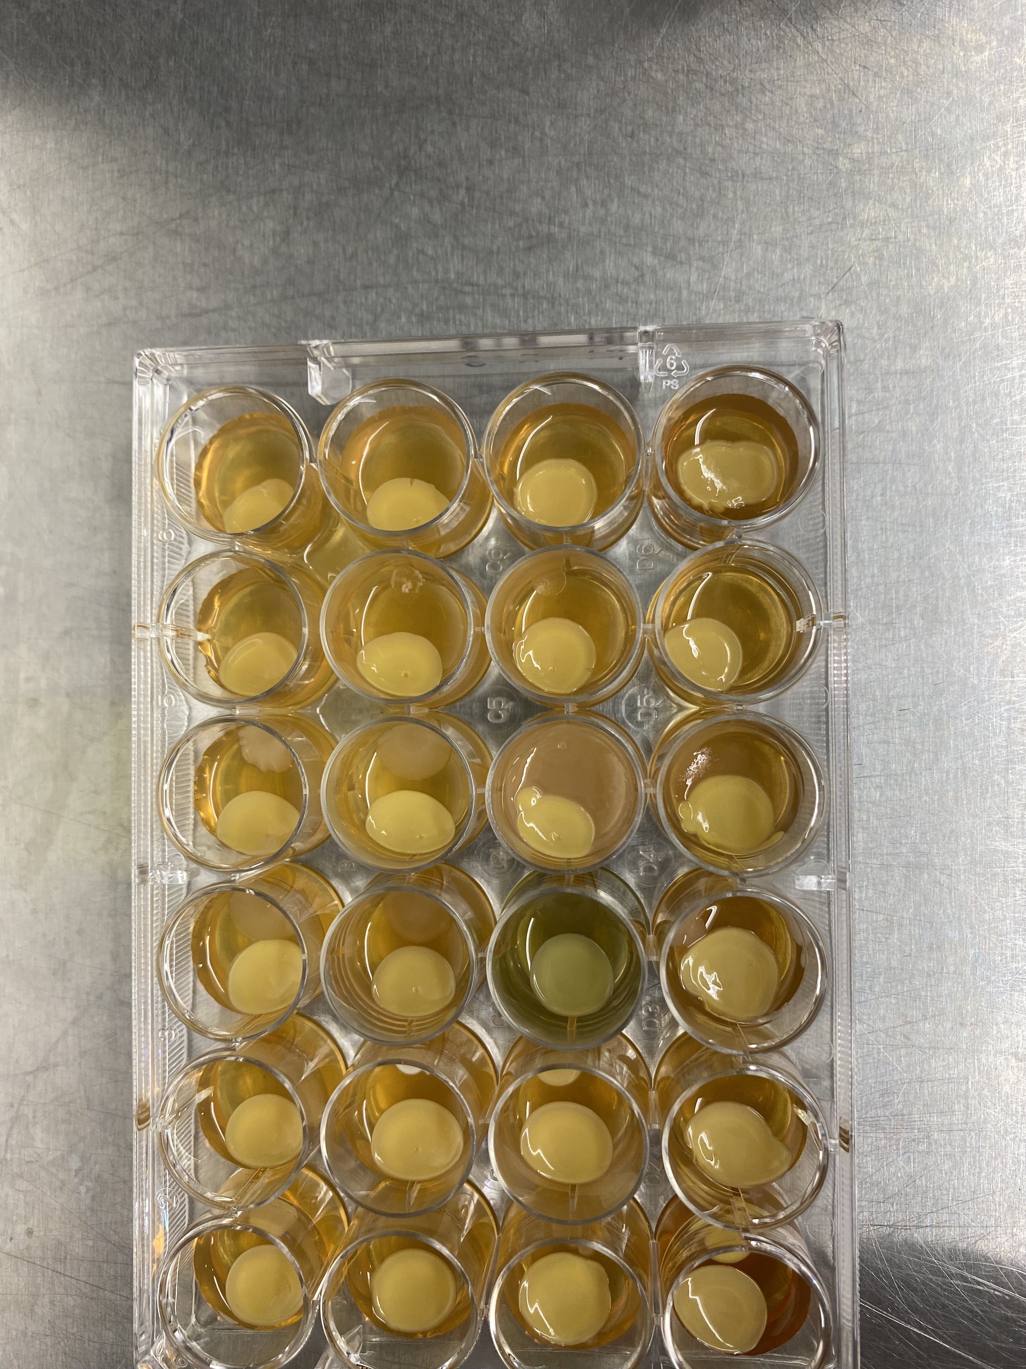
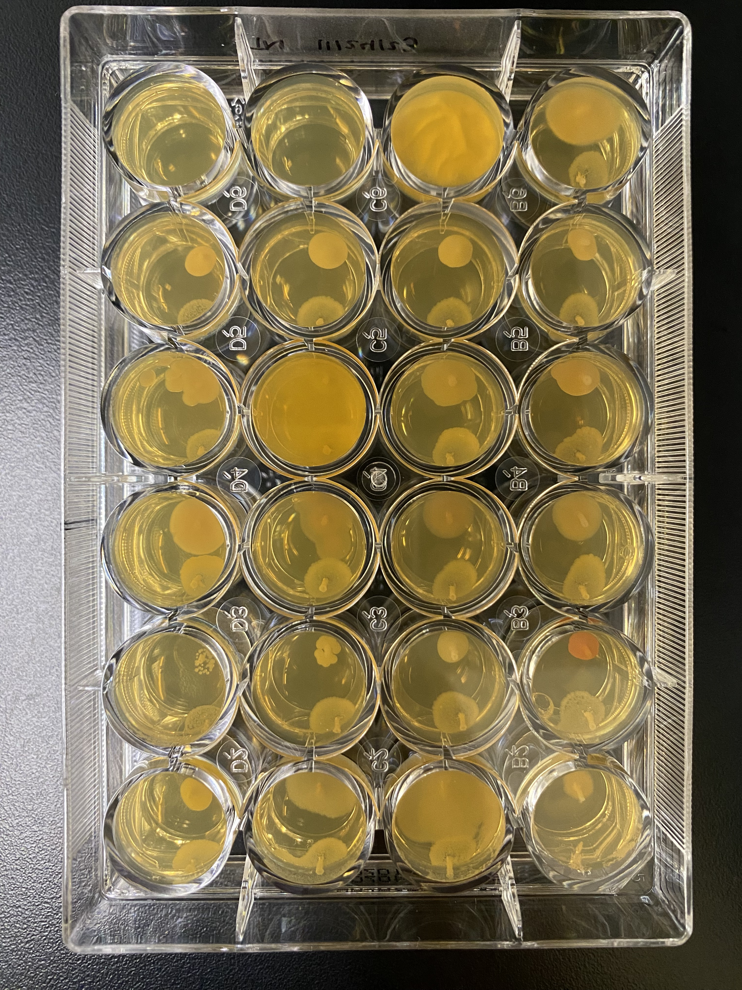
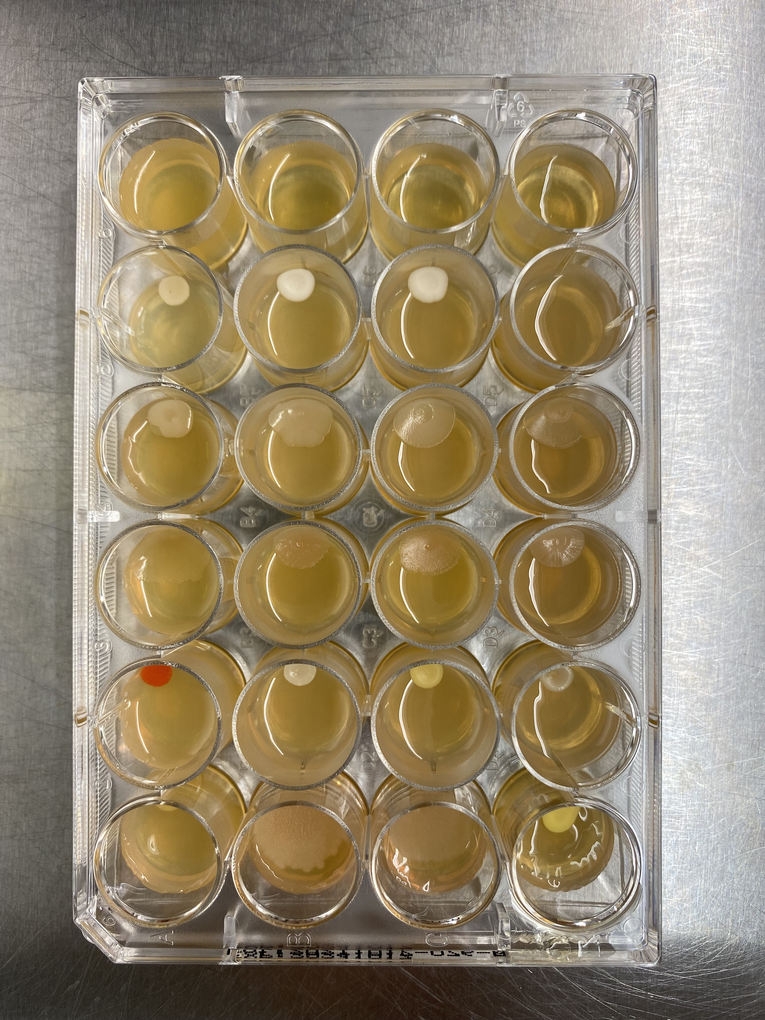
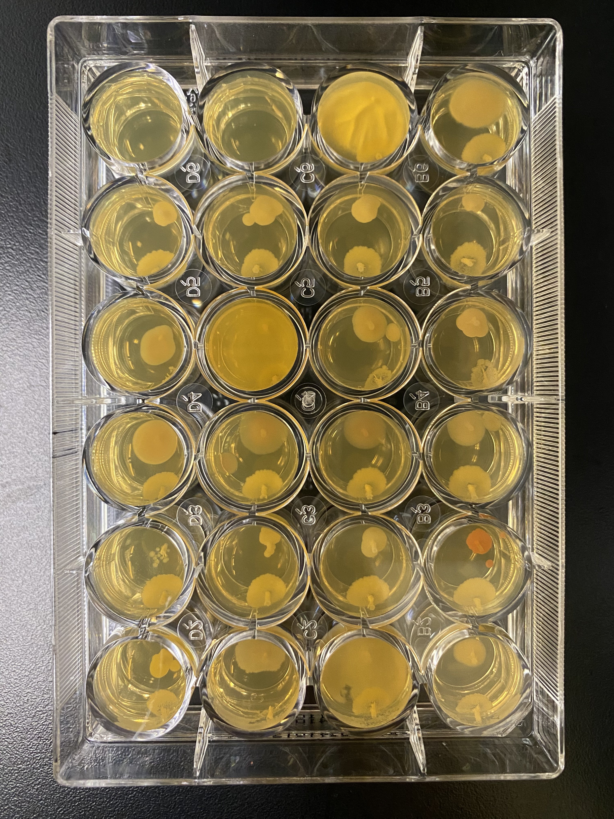
LK952
LK960
LK1337
LK1188
Control
Micrococcus luteus
Pseudomonas aeruginosa
Candida albicans
Aspergillus flavus

Slide 3
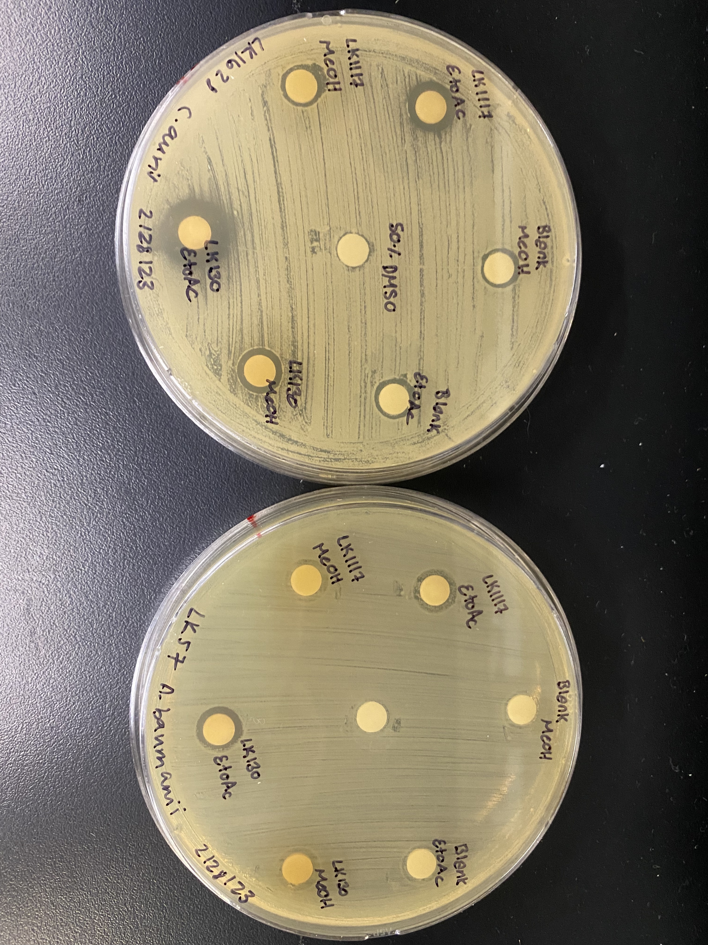
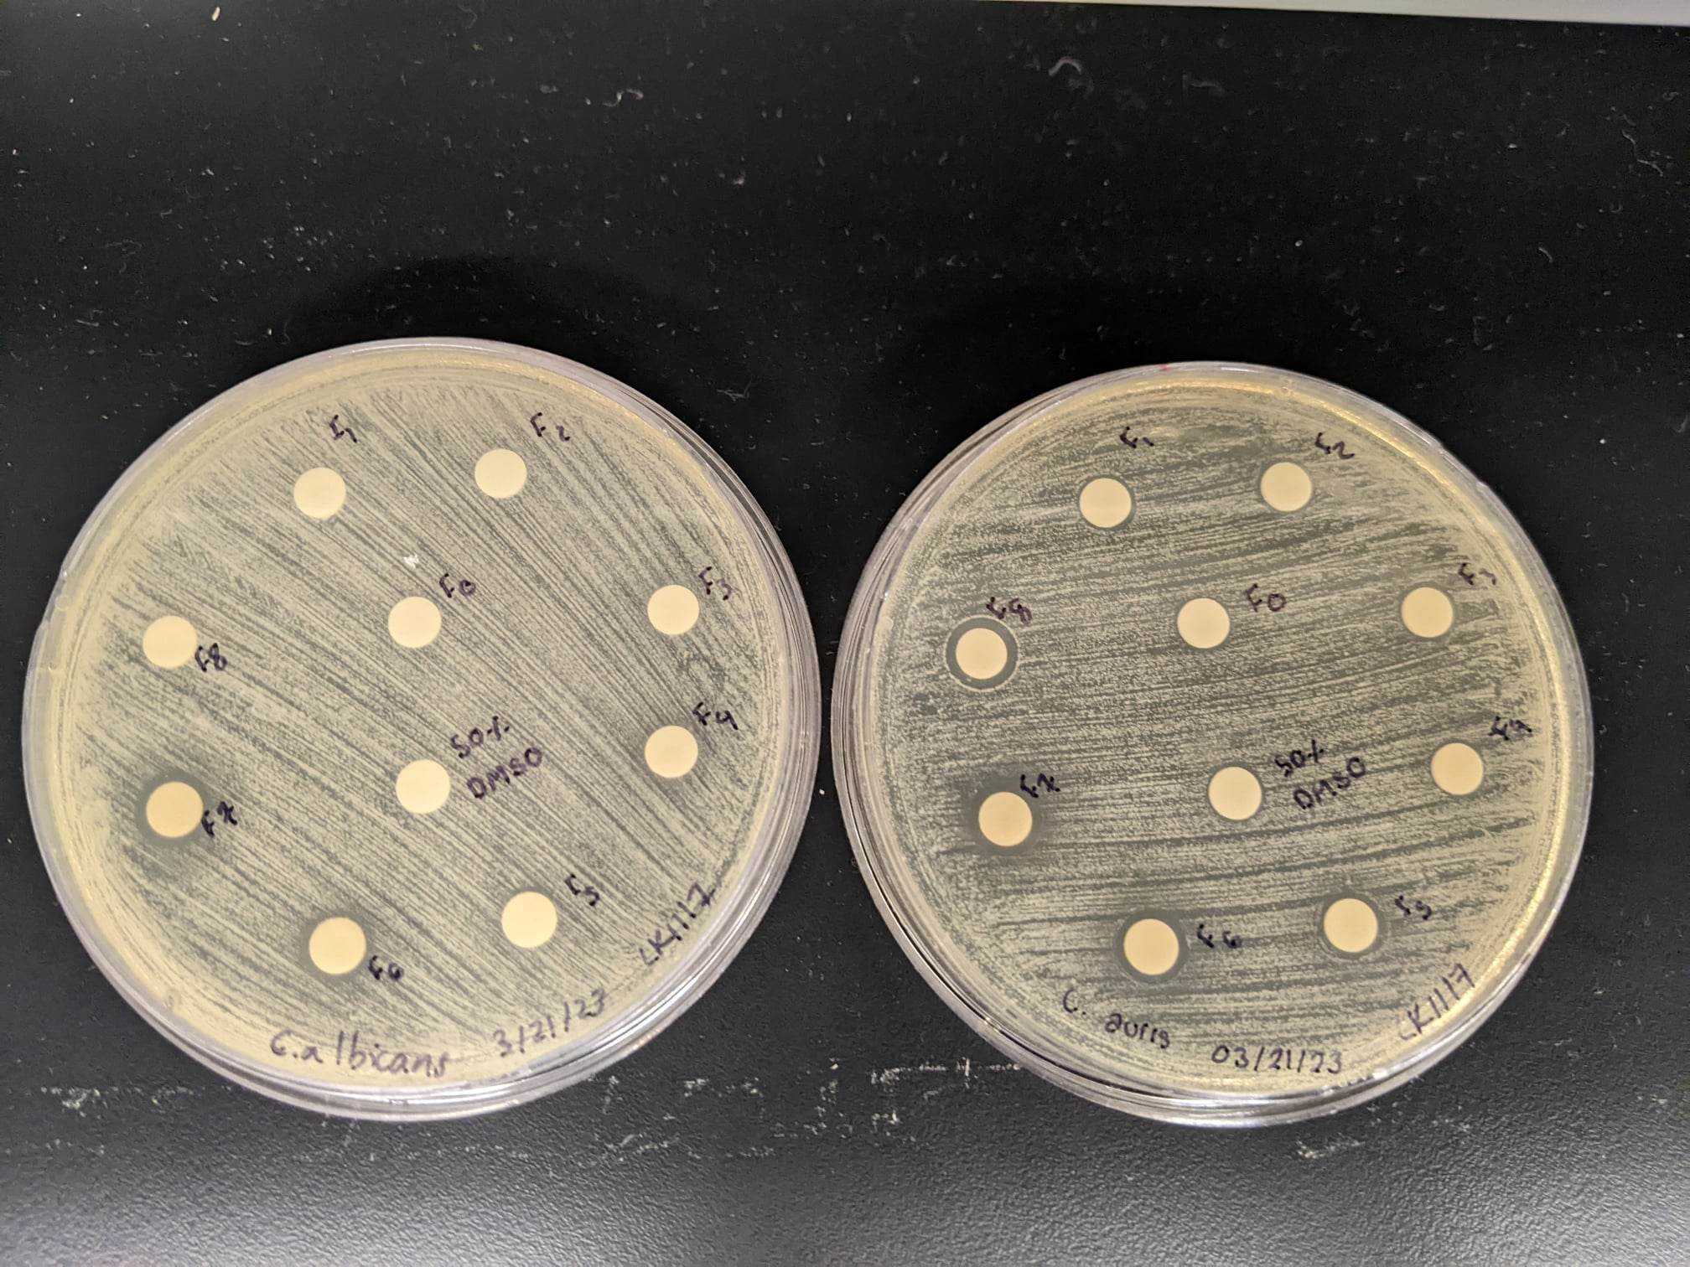
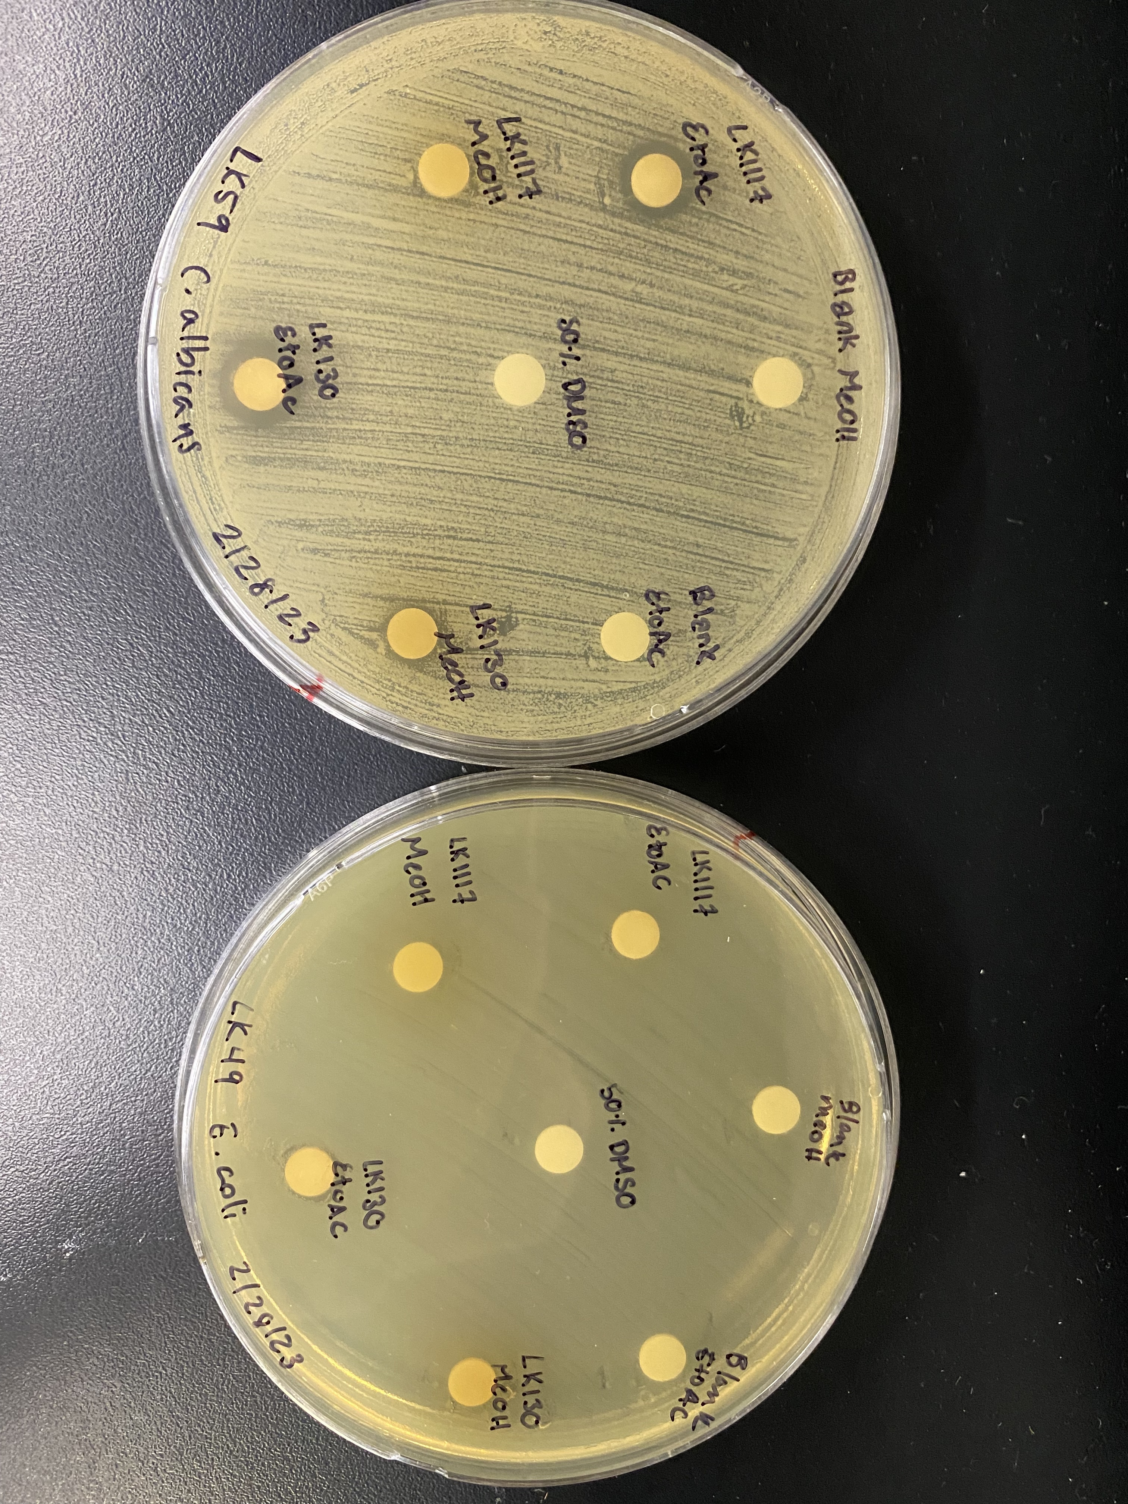
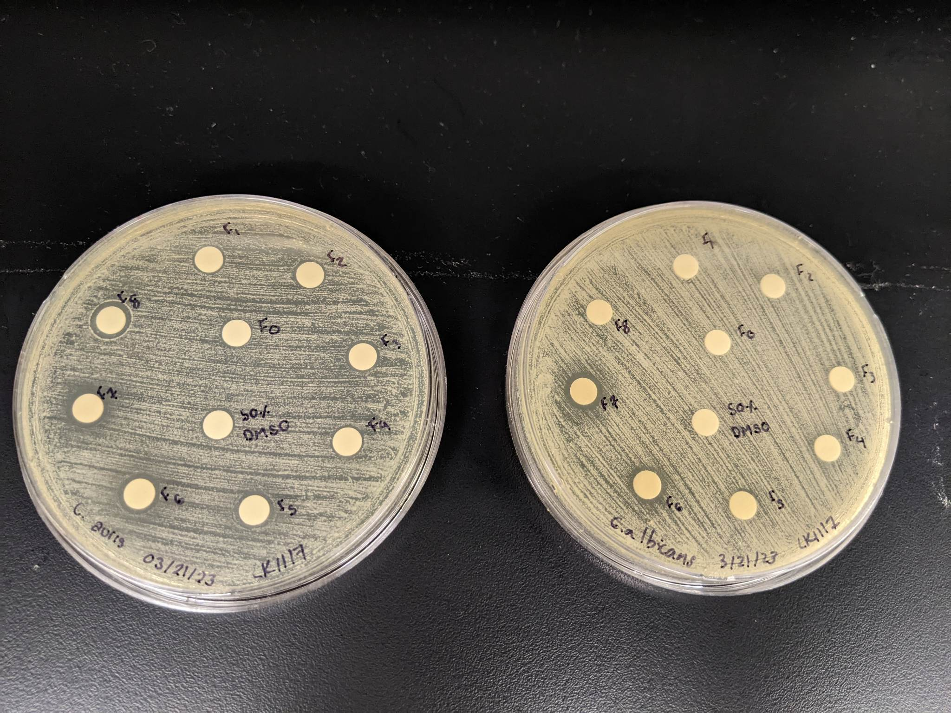
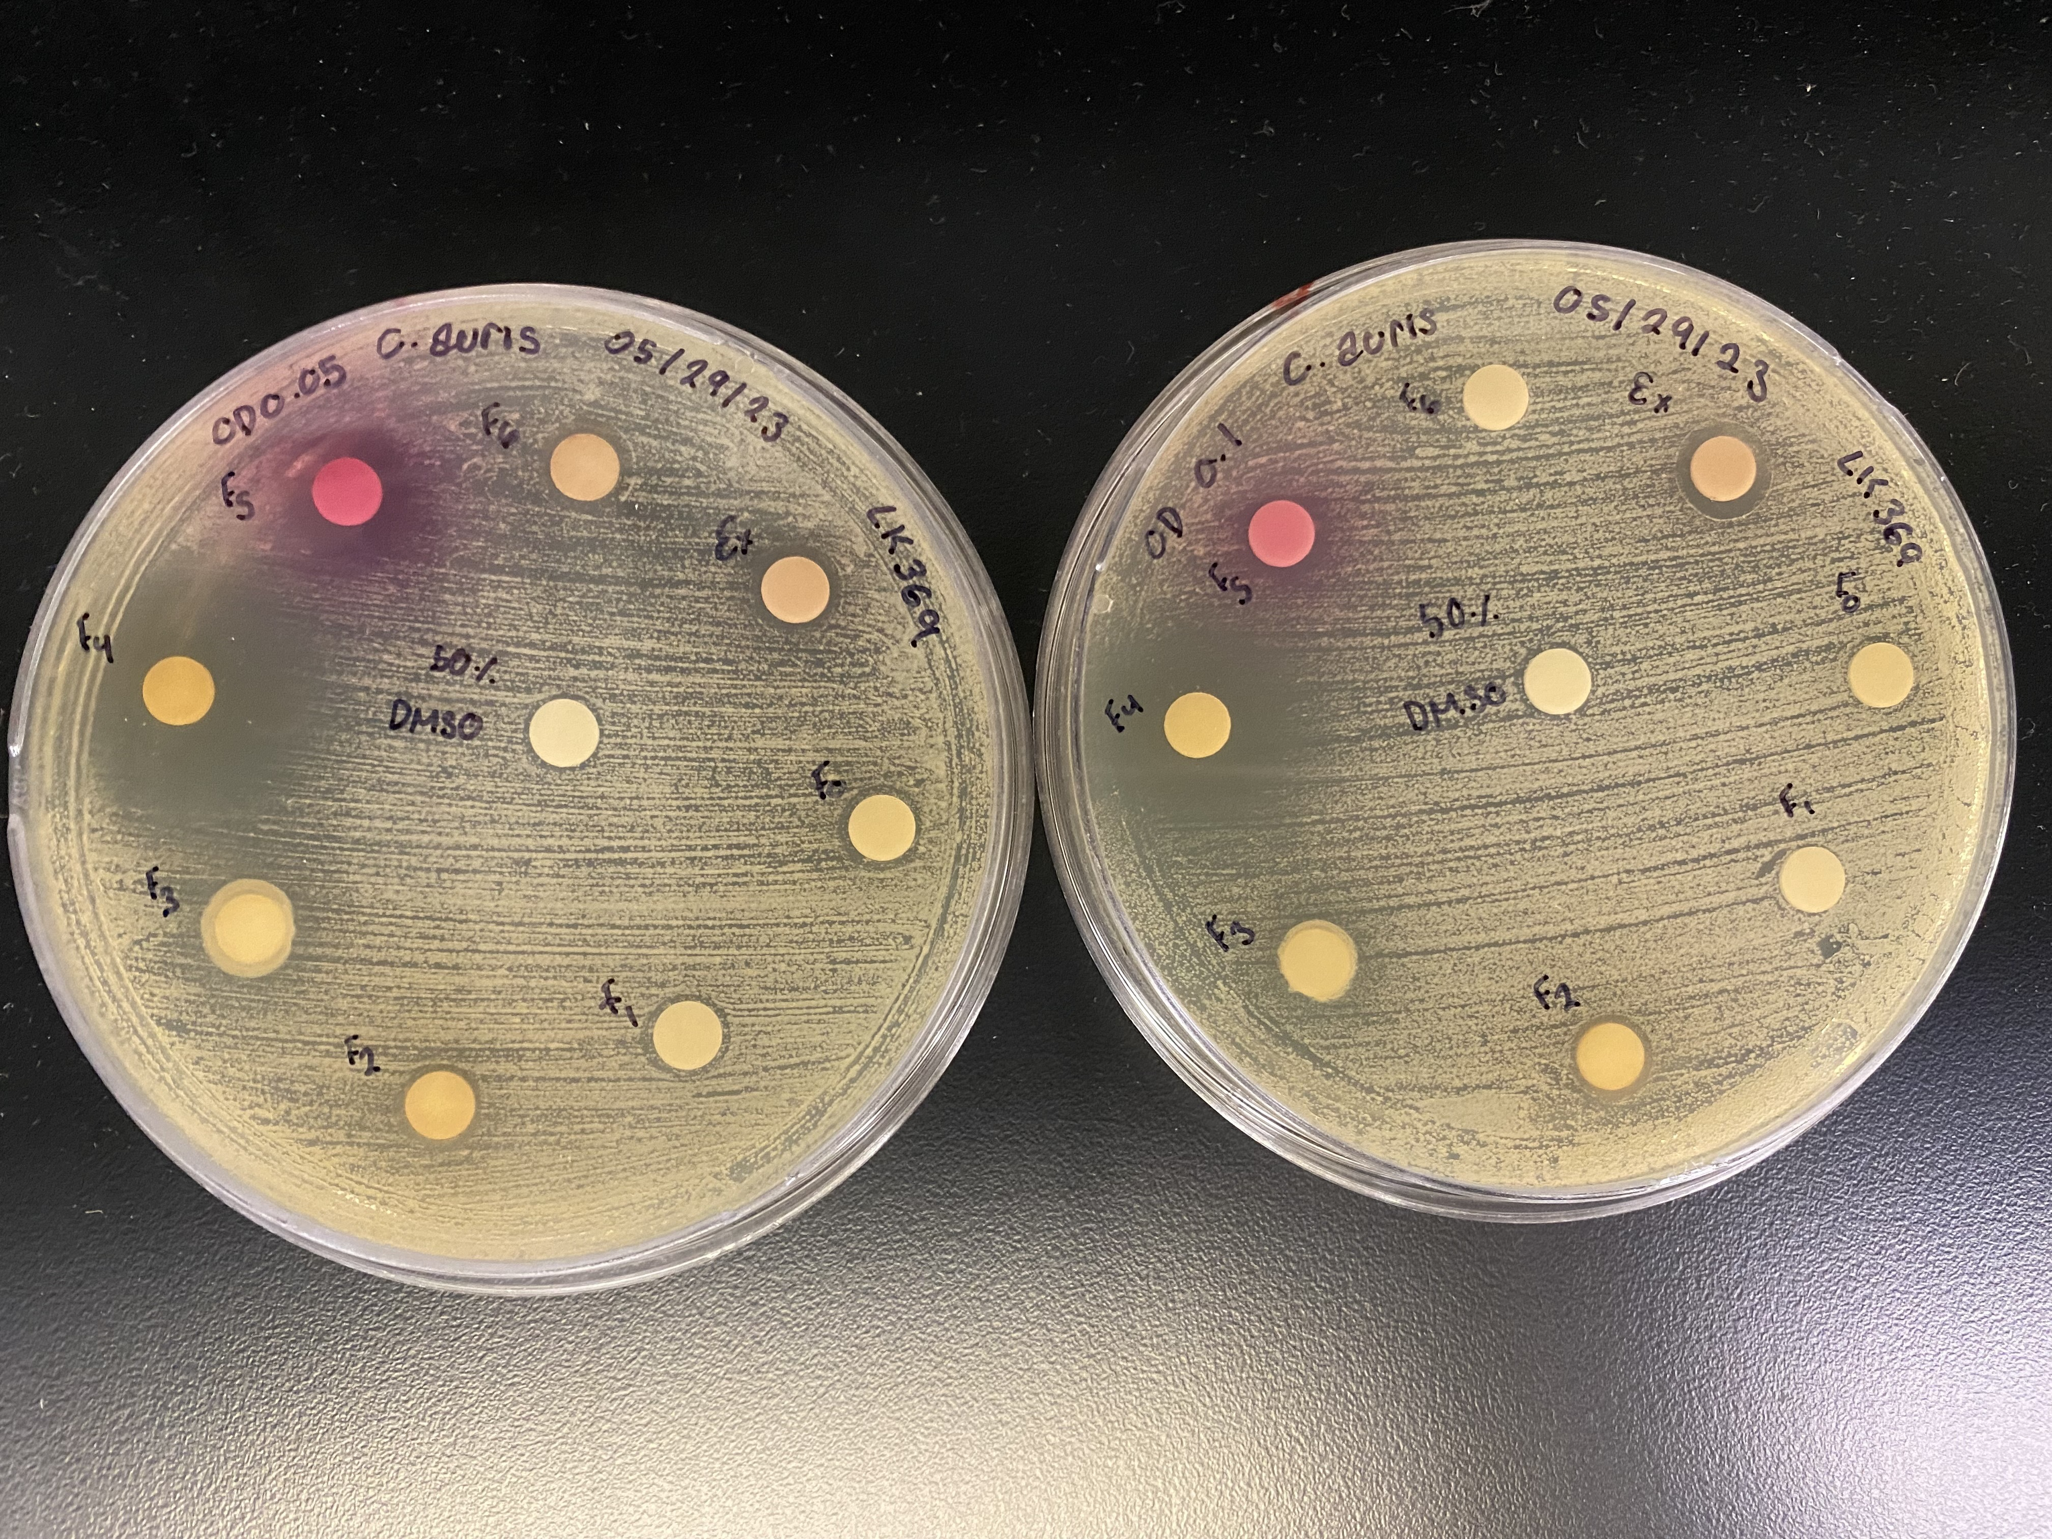
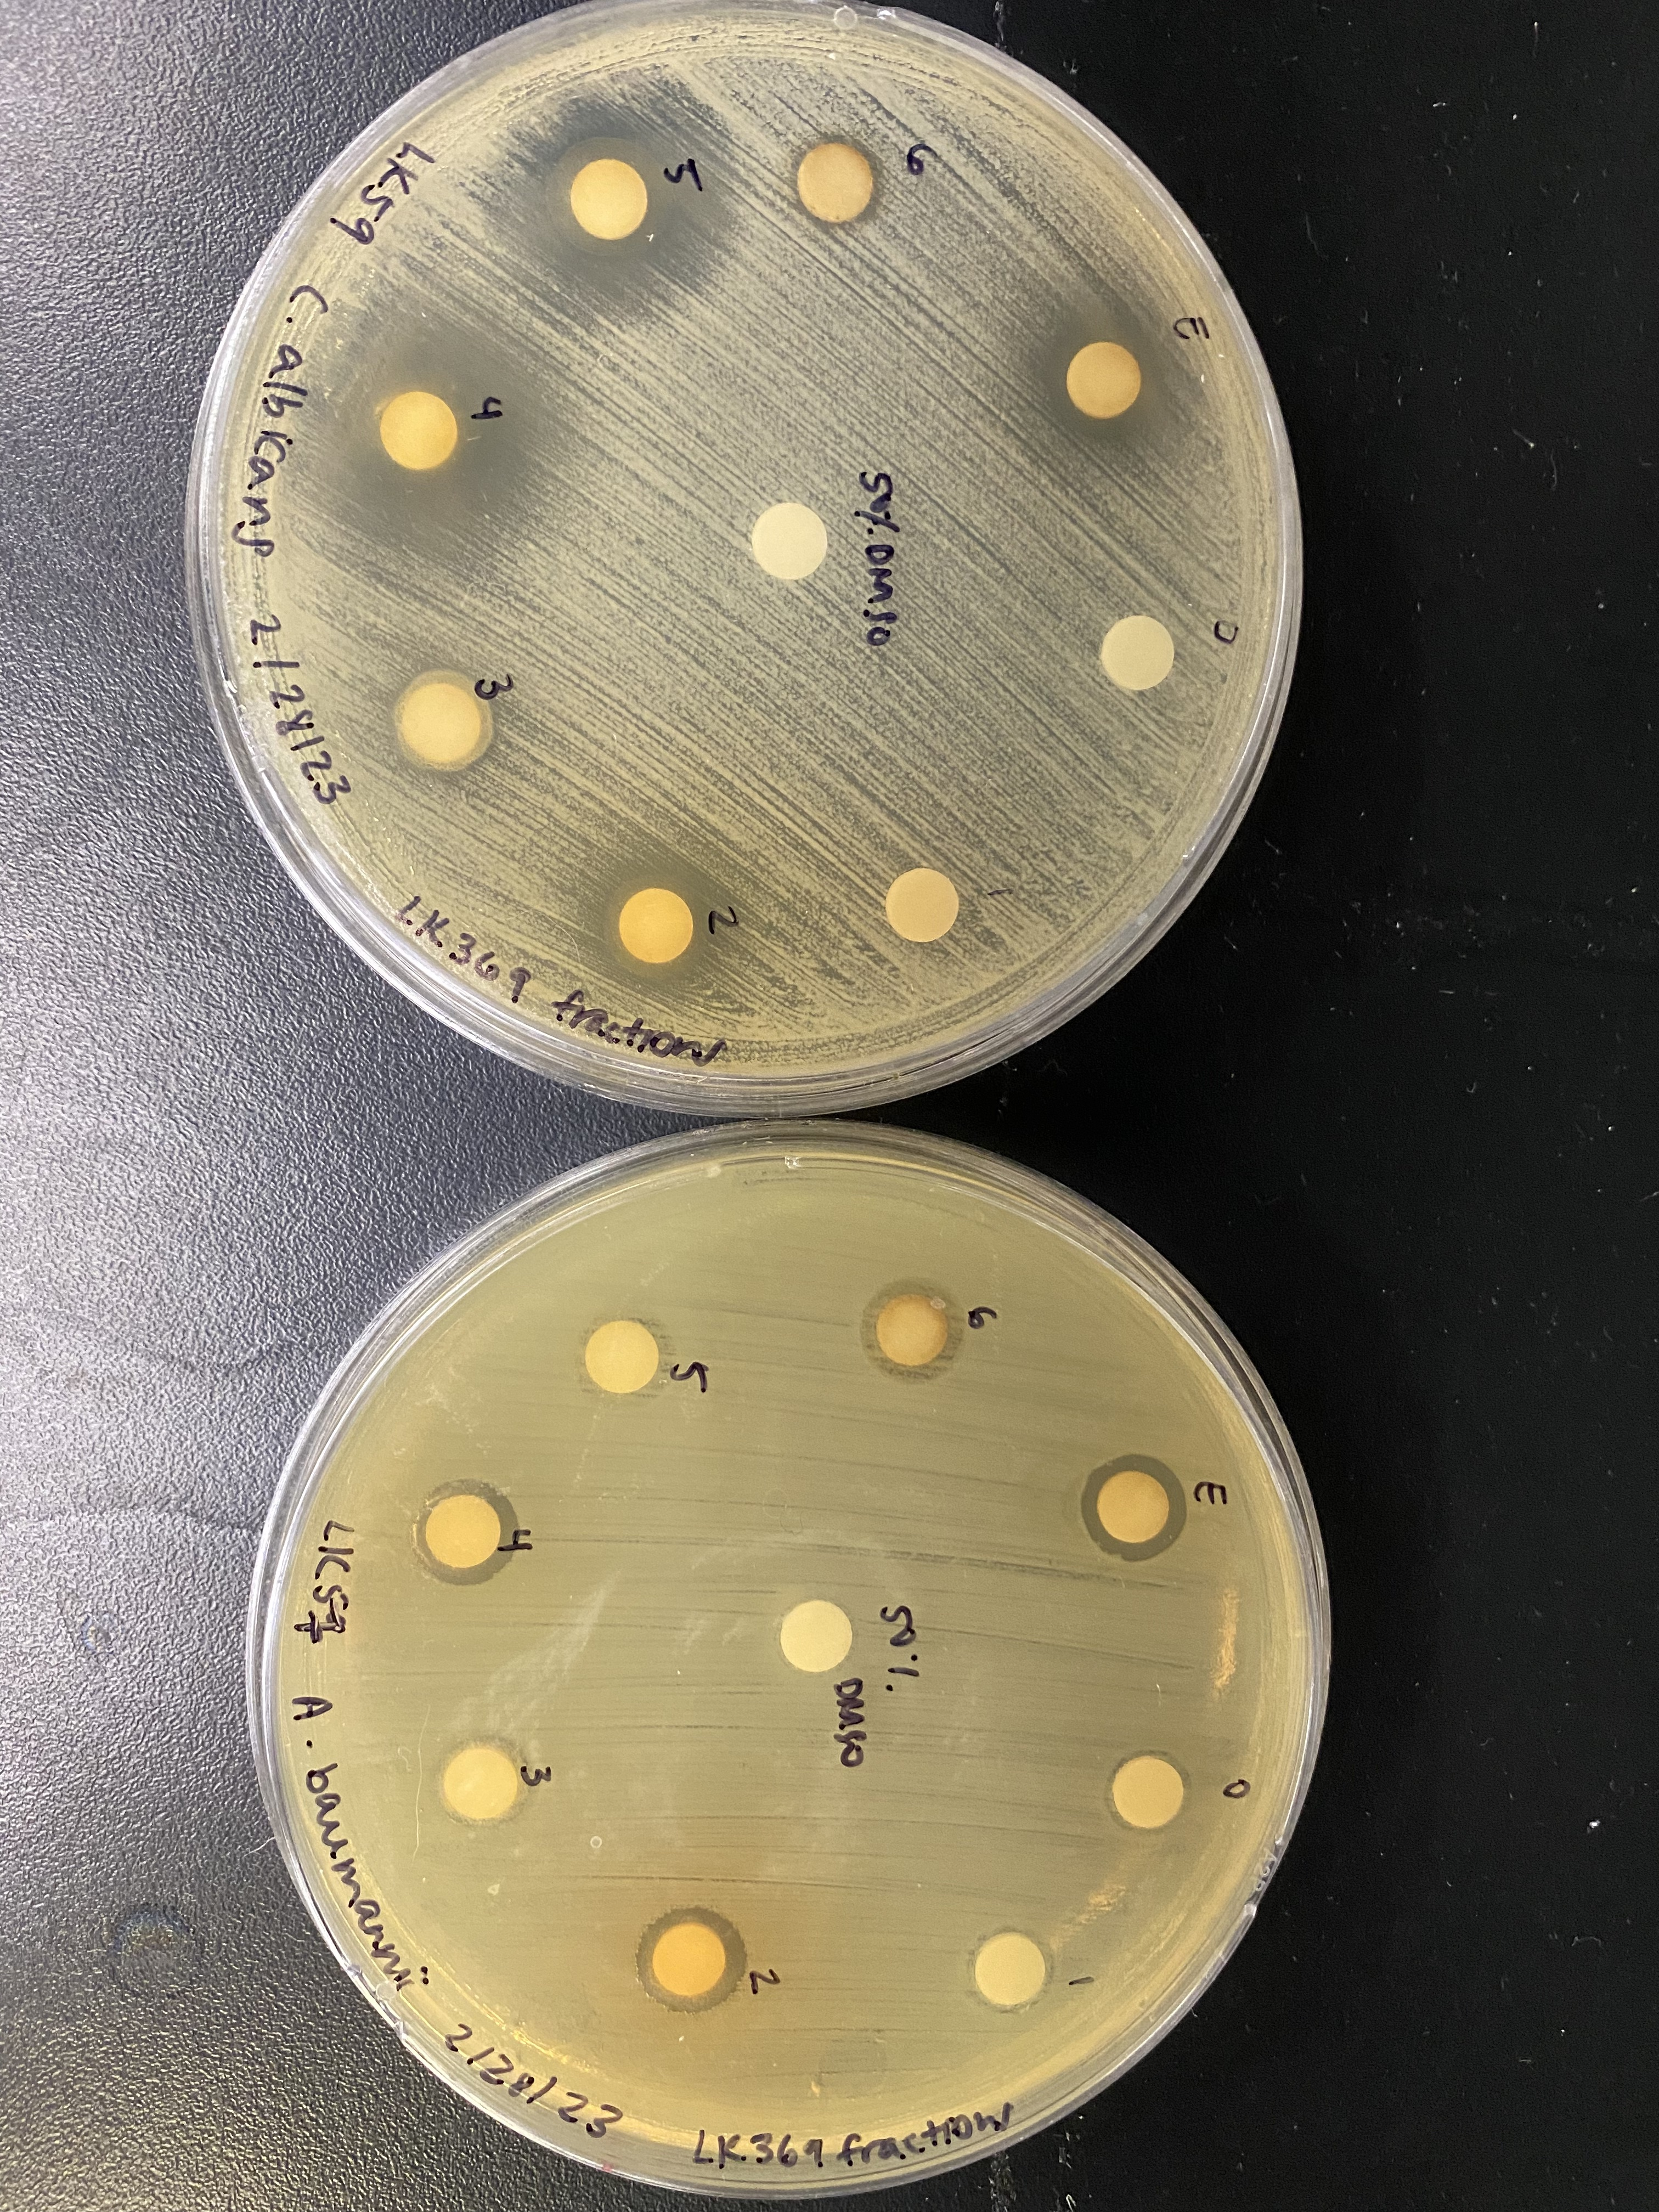
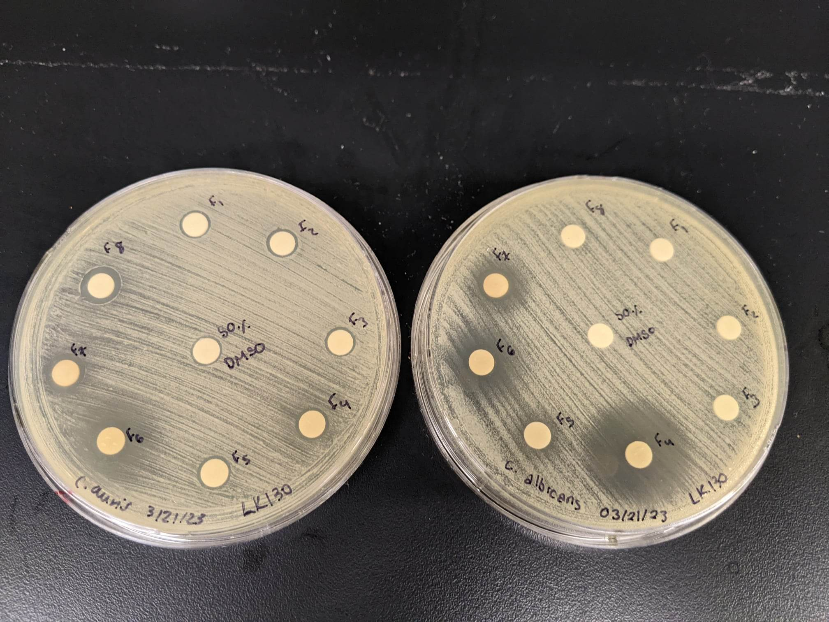
C. auris B11211
C. albicans K1
Crude
Active Fraction
Crude
Active Fraction
LK1117 Micrococcus
LK369 Microbacterium
LK130 Helcobacillus

Slide 4
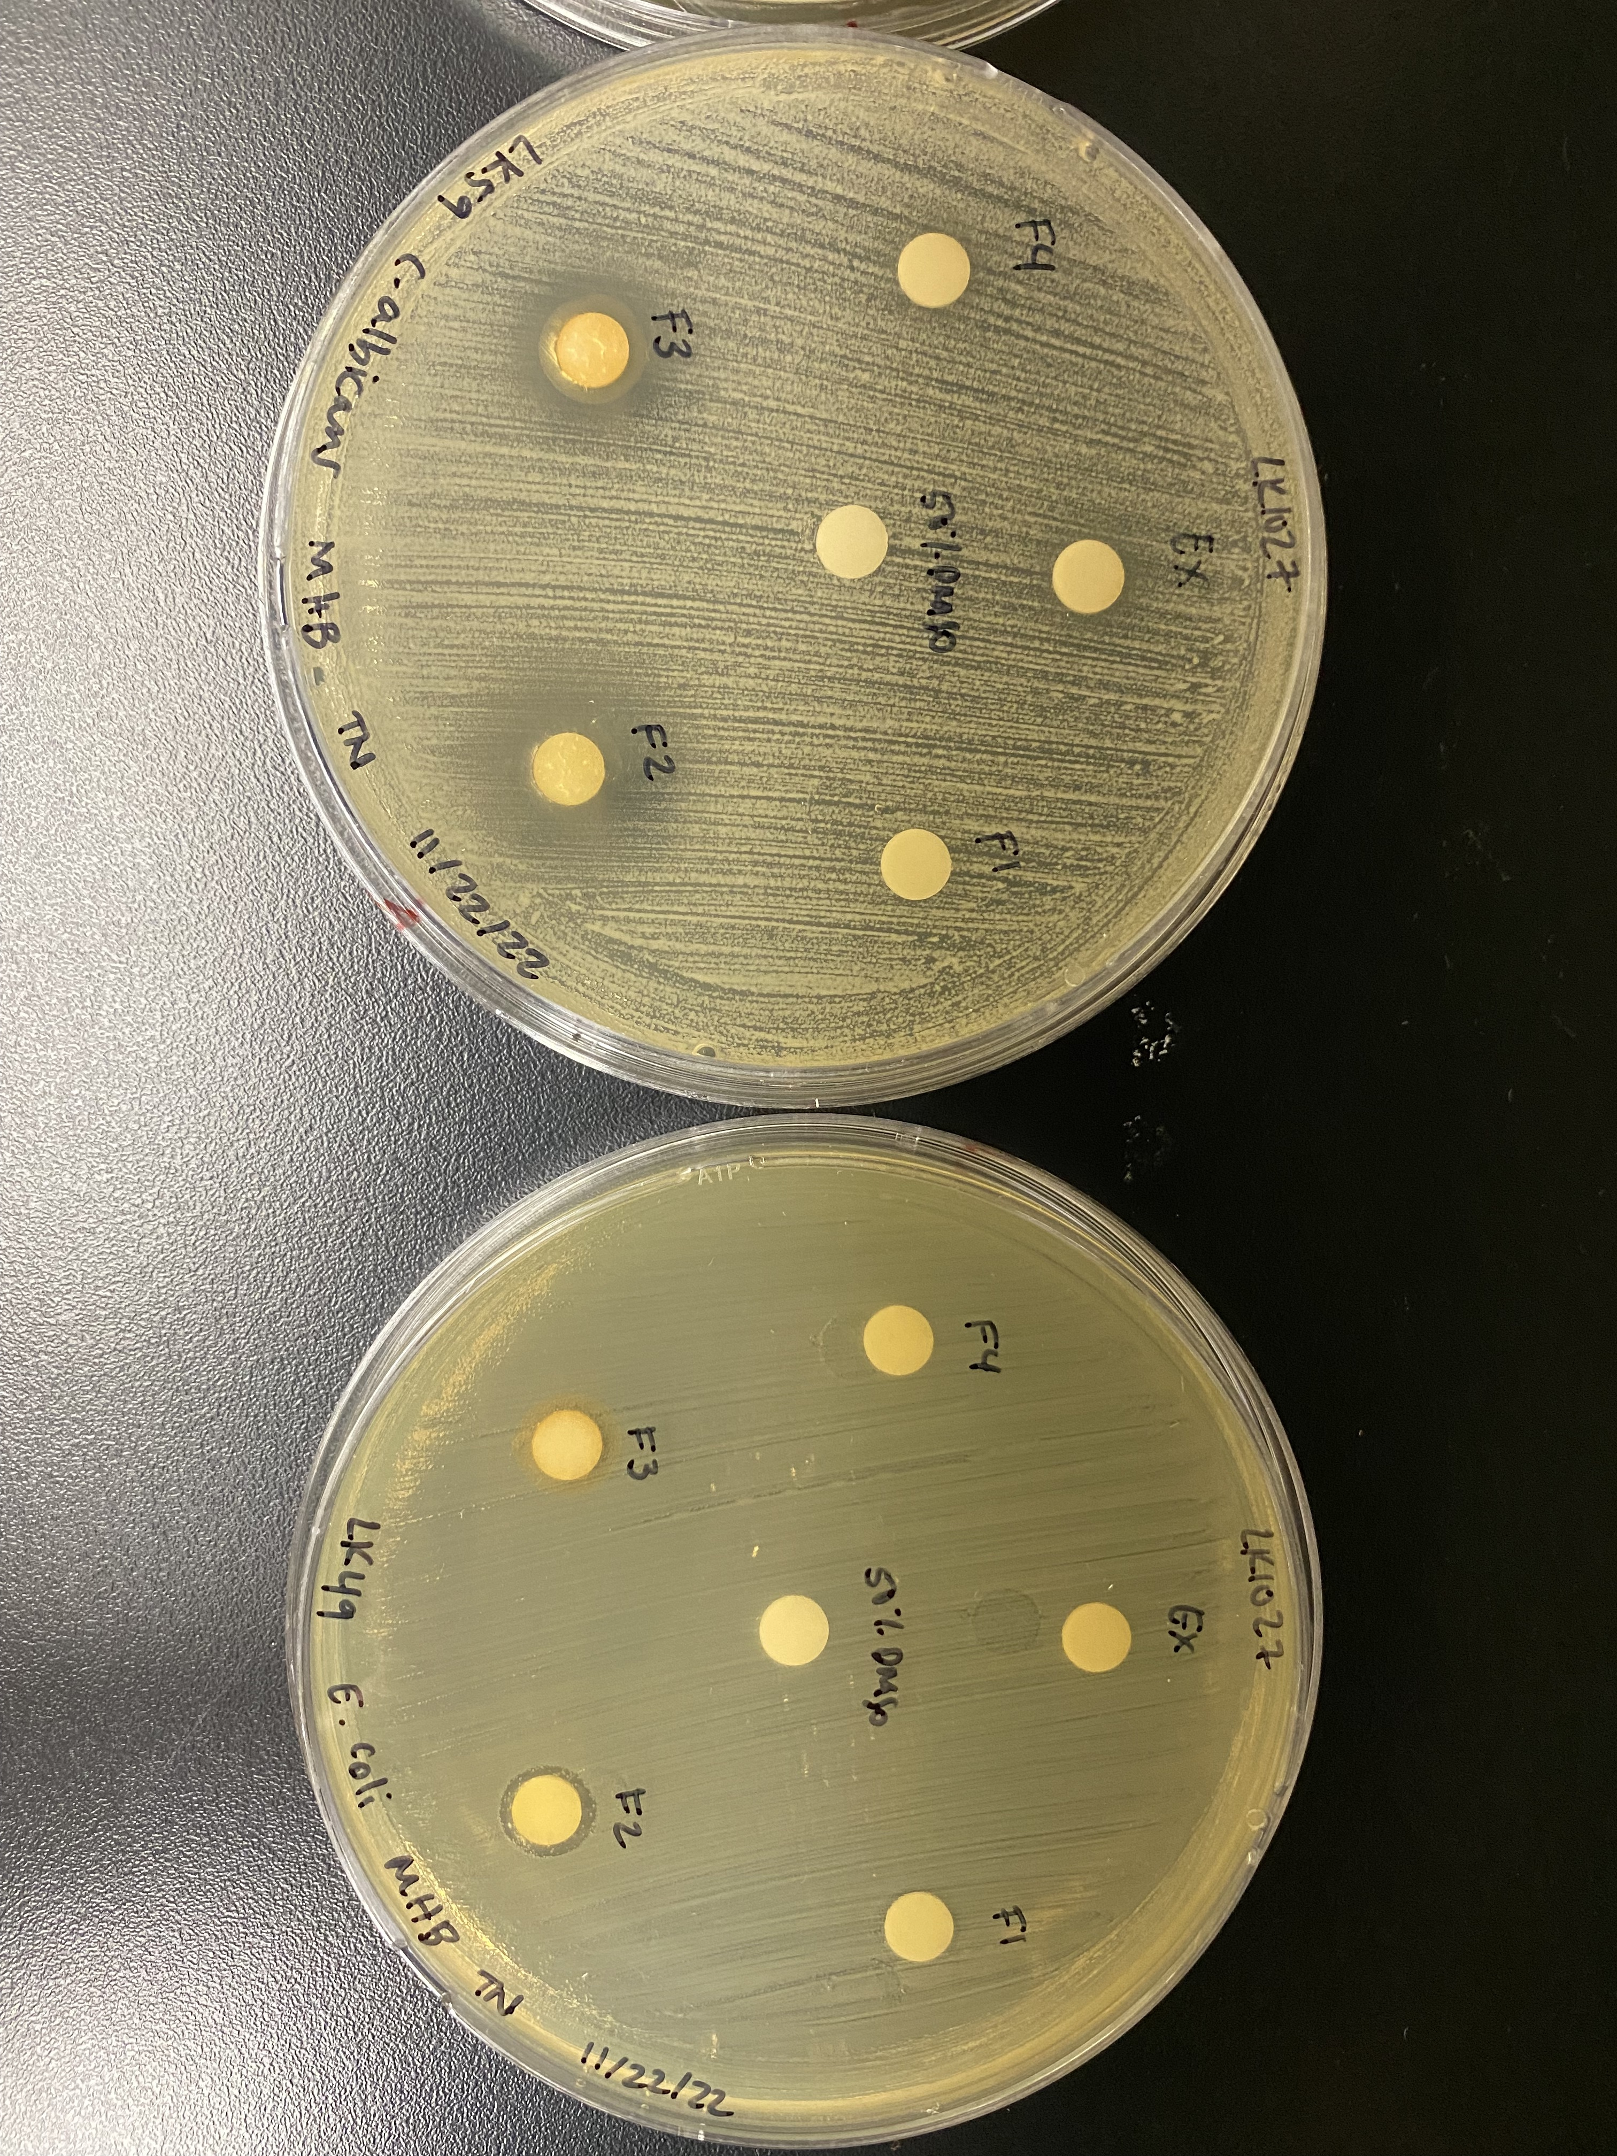
A
B
C. auris B11211
C. albicans K1
Crude
Active Fraction
Crude
Active Fraction
LK1117 Micrococcus
LK1117 Micrococcus
LK369 Microbacterium
LK369 Microbacterium
LK130 Helcobacillus
LK130 Helcobacillus
LK1027 Brevibacterium

Slide 5
A
B
C. auris B11211
C. albicans K1
Crude
Active Fractions
Crude
Active Fractions
LK1117 Micrococcus
LK1117 Micrococcus
6
7
8
6
7
LK369 Microbacterium
LK369 Microbacterium
4
5
4
5
LK130 Helcobacillus
LK130 Helcobacillus
6
7
8
4
5
6
7
LK1027 Brevibacterium
2
3

Slide 6
A
LK1117 Micrococcus
B
LK1117 Micrococcus
C
LK1027 Brevibacterium
EX
EX
EX
0
1
2
0
1
2
1
2
3
4
5
3
4
5
3
4
6
7
8
6
7
8
-
-
C. auris B11211
-
C. albicans K1
C. albicans K1

